Slide 1
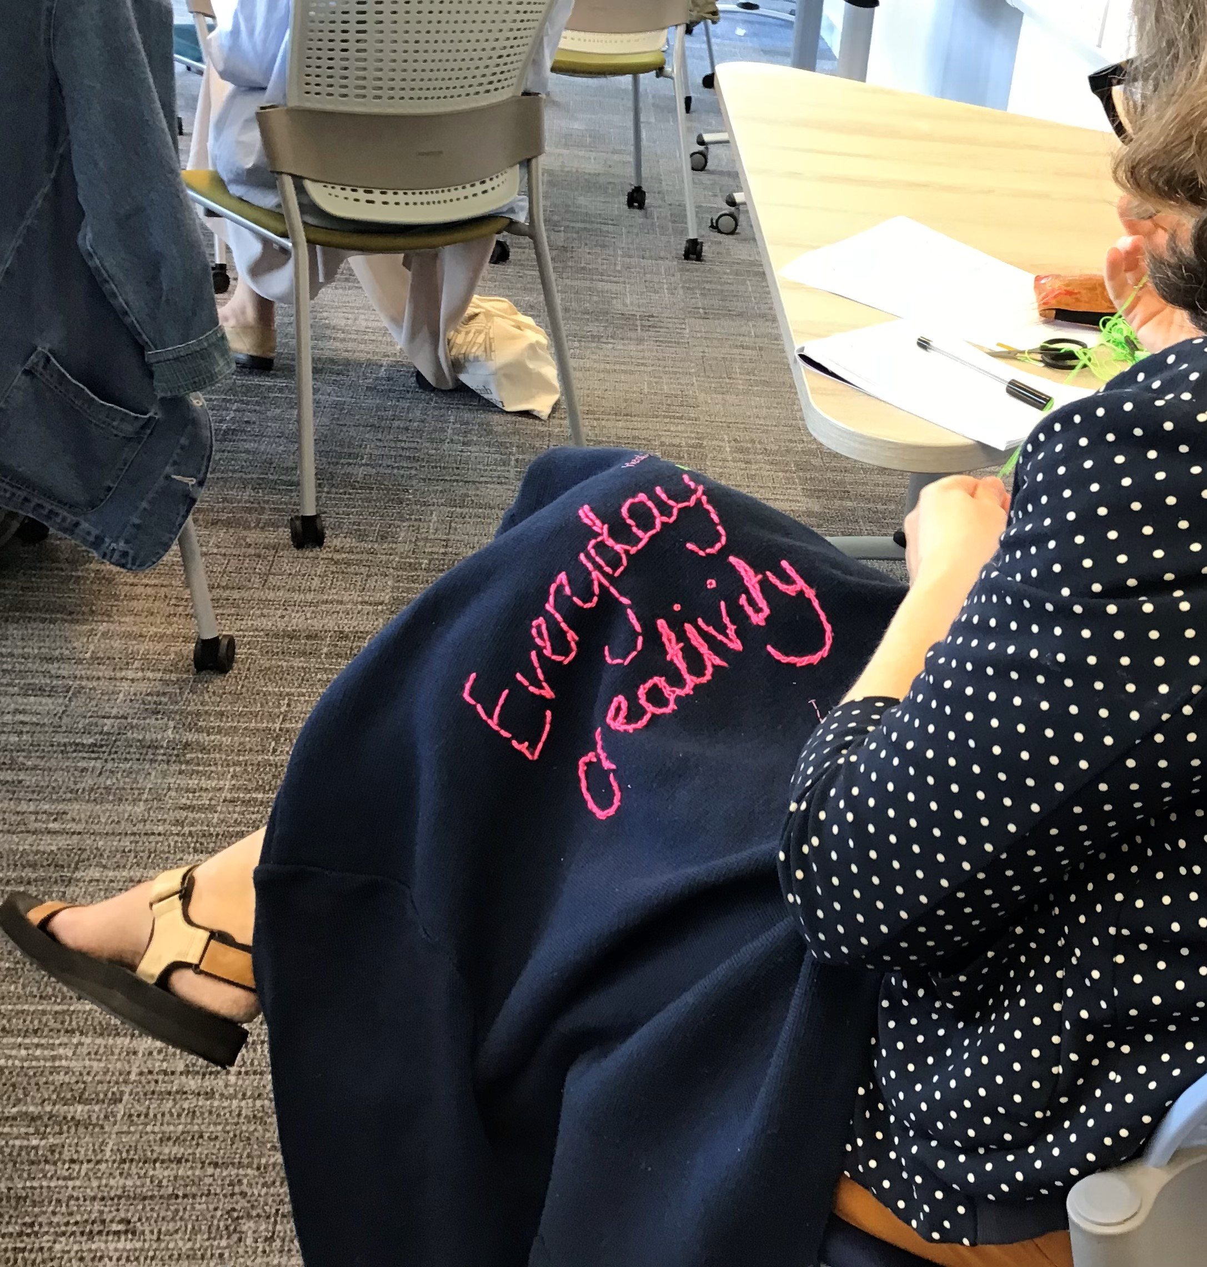
Towards Democratising Research: Lessons from Everyday Creativity
Helen Johnson, University of Brighton
Notes:
There is a pressing need for academic scholarship as a whole, and social scientific research in particular, to be more relevant, inclusive and impactful for the communities who are (or should be) at its heart. This ties in to the impact agenda in academia, and to current movements to decolonise and democratise the Academy. Community-university partnerships and participatory research methods respond to these concerns in different, but complementary, ways, seeking to challenge dominant paradigms around the definitions, practice, ownership and application of knowledge and knowledge production. These approaches are becoming increasingly sought after within both academic and community contexts for their ability to speak to, include, and act with, communities of interest. Too often, however, this work remains tokenistic. Organisational constraints and resource limitations in both spheres can limit the extent to which research is truly democratic, and this is compounded by a reluctance to cede power within the Academy. Furthermore, too often, we fail to realise the limitations of our own preconceived paradigms, treading the same well-worn paths, while maintaining that we are doing something radically new and different, or walking parallel paths to our research ‘partners’ while believing we are all, in fact, on the same track. ‘Everyday creativity’, with its focus on innovative synergistic practice, community-led action, meaningful engagement and impact has the potential to redress these limitations. This talk presents a model and resource pack for community-engaged research underpinned by everyday creativity principles, drawing on my experiences of collaborating in community-university partnership projects and my work co-developing an international research network for everyday creativity.

Slide 2
‘The Weirdest People in the World?’ (Henrich, Heine & Norenzayan, 2010)
Notes:
There is a large body of literature attesting to the insular, restrictive nature of much social scientific scholarship. Henrich, Heine and Norenzayan’s (2010) seminal article powerfully critiques psychological research for its disproportionate focus on participants from WEIRD (White, Educated, Industrialised, Rich and Democratic) societies, arguing that these individuals are far from typical on a global scale, and that generalizing conclusions based on such skewed samples presents a fundamentally misleading and artificially homogeneous view of human nature.
Although their decade-old article concludes by making suggestions for how behavioural scientists could tackle this issue, the bias they describe remains very much a current problem.

Slide 3
Notes:
Even within WEIRD societies, research is restricted in who it researches, take as examples:
Women (often excluded from medical research all together due to pregnancy risk, menstrual fluctuations etc. E.g. The Baltimore Longitudinal Study of Aging, which began in 1958 and purported to explore ‘normal human ageing’, didn’t enrol any women for the first 20 years it ran)
so-called ‘hard to reach’ groups (better termed ‘underserved’ or ‘marginalised’): Widely used to refer variously to ethnic/sexual minorities, homeless popn., disabled people, older people, people with low literacy/computer literacy or access etc.
The restrictive focus of much social scientific research is more than simply a sterile methodological issue of representativeness. Instead, it is a process that is centred in, and reproduces, unequal power relations, by establishing a very particular way of being (WEIRD, white, straight, CIS, middle class male) as normal and desirable.
So you have research that often lacks meaning for its subjects; lack of meaning and relevance equates to lack of impact in communities. This can be a matter of life and death, eg Of the 10 prescription drugs taken off the market by the US Food and Drug Administration between 1997 and 2000 due to severe adverse effects, eight caused greater health risks in women, while recent research on NHS colour charts as part of Apgar test used to assess newborns (detect for jaundice, cyanosis) has been linked to greater deathrates amongst non-white infants.

Slide 4
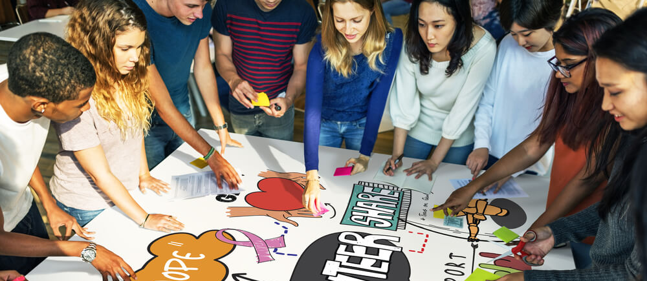
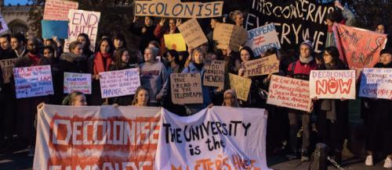
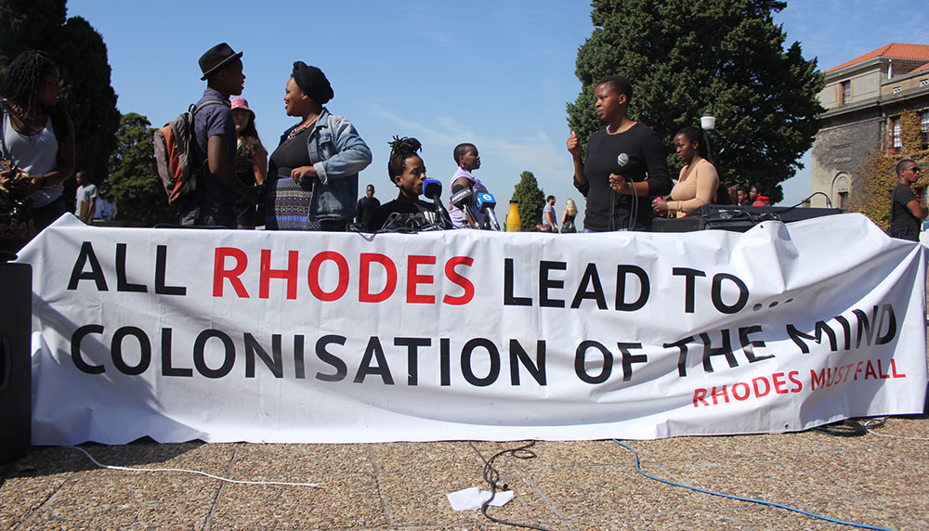
Notes:
Issues like these have been widely discussed as part of moves to decolonise and democratise the Academy. These have risen to prominence in recent years, most notably with student-led action to decolonise the curriculum, which is typically traced back to the 2015 Rhodes Must Fall campaign at the University of Cape Town. Participants in this movement have condemned the white, Western, English-speaking (and often Anglo-American) bias of much academic scholarship, highlighting how this excludes individuals within and beyond the Academy, producing a distorted view of both the fields studied and the nature of scholarship itself.
The need to democratise scholarly practice applies to both ‘pure’ and ‘applied’ approaches to knowledge creation, affecting, as it does, the authenticity, robustness, relevance, transferability and impact of research.
Furthermore, the drive to make research more inclusive, meaningful and impactful speaks to the responsibilities that academics have to the communities who are impacted by their research and scholarship. This social responsibility agenda completes the tripartite model of the Academy, which stresses the university’s role in providing service to the wider community, as well as advancing knowledge and creating literate citizens, although service was, for many years, overshadowed by the other two pillars, it has come firmly back onto the agenda more recently, in line with an increasing emphasis on the employability needs of graduates and businesses, public engagement with research, and research impact.

Slide 5
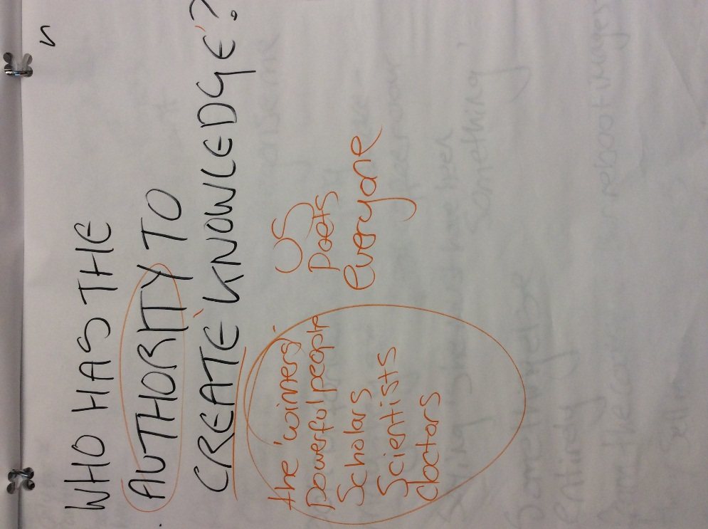
Community-Engaged Research: Participatory Research, Community-University Partnership Working and Co-Production
Notes:
‘Community-engaged research’ is a broad term used here understood to incorporate a range of different approaches emphasising partnership, co-production, and/or other forms of participatory engagement with community groups and organisations. Such research is increasingly held up as a model for impactful and meaningful academic practice that fulfils the social responsibility duty of the tripartite model, and supports the democratisation of research.
Approaches framed by an ideological model that speaks to social justice and transformation, seeking to enhance capacity within the community, empower citizens and/or modify social structures through mutually-beneficial partnerships, co-production, skill/knowledge exchange. Challenges the common tendency to view people outside of the Academy as passive research subjects or recipients, repositioning them instead as active partners who can bring considerable value to research, providing practical knowledge and intimate understandings of communities, facilitating access to (other) marginalised individuals, and enriching ecological validity and research impact
Consequently, they hold real potential to democratise research practice, enabling researchers to, not only amplify the voices of marginalised communities, but also centre the concepts, issues, frameworks of understanding and ways of working that are meaningful to them.

Slide 6
The Problem:
We are frogs in bromeliads (and we don’t want to share our flowers)!
Notes:
This potential often remains unfulfilled in practice however. Instead, so-called ‘community-engaged’ research is all too often tokenistic, poorly-resourced and/or insufficiently responsive to the needs of communities. This is exacerbated by the myopic ‘publish-or-perish’ culture within academia, and by the common need to provide funders and institutions with immediate, concrete outcomes that sit poorly with the relatively slow-burning, diffuse and complex practices and outcomes associated with more inclusive, participatory approaches.
Accordingly, both academic and community partners have voiced concerns that community-engagement is often merely given ‘lip service’ in order to meet national and institutional research agenda or funding body criteria.
Compounded by difficulty in seeing/questioning our own assumptions. How can you know about the limitations of a world within which you are created? (ref: frogs in bromeliads).
It’s only once you start truly collaborating with others and including them that you can even begin to address this and that starts with ourselves, our concepts, our methods, questioning the roots of what we are doing thinking.
Ref HKP partnership and realisation of how far away we were from one another even at end. Even our respective notions of what ‘research’ is remained relatively far apart at the outset of this second project, with me using the term to refer predominantly to the collection and analysis of empirical data, and Nicole to the review and synthesis of published data from national reports, Local Government statistics and other sources.
Led to new partnership to develop model and resources aimed at tapping unrealised potential of community-engaged research.

Slide 7
Notes:
project to develop a Community Research Resource Pack that could be used by community organisations to carry out research independent of any academic involvement.
materials were co-produced by the authors through an iterative process that worked with three teams within TDC, four additional community organisations and over 90 community participants to develop materials in situ and in response to immediate need. So, materials were developed responsively, in line with the needs of communities, and the capacity and working practice of participating organisations.
This collaborative working process served to centre community organisations and the communities they serve, flipping the power dynamic where, even with much CUP and participatory research, academics typically retain ultimate authority over research processes, applications and outcomes.
This has led to increased confidence and capacity within participating organisations to cascade learning and to guide colleagues and teams through the research process, embedding opportunity for critical reflection and identifying where further research would be beneficial. The resources have also facilitated cross-communication and sharing of outcomes between participating groups/teams, as well as within teams. On a concrete level, they have been integrated into TDC’s impact review and planning processes, and have been directly incorporated into several funding bids.
These impacts were only possible because of the creative, flexible and relationally-focused way in which we worked together as partners. It was this that enabled us to question our established understandings and practice on a deep level. This, in turn, was predicated on an awareness of how far apart we stood in the first place.

Slide 8
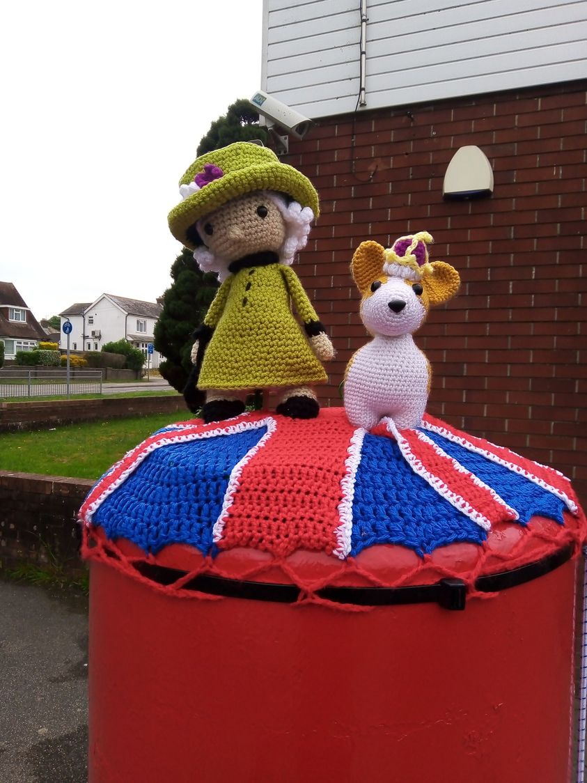
Everyday Creativity
https://blogs.brighton.ac.uk/everydaycreativity/
Artwork by Louise Jenner
Notes:
As we reflected on this process of moving from thinking apart to coming together, we came to see the synergy between this and the everyday creative practices that we had explored in our first partnership together and I am exploring in ECRN.
By focusing on process over product, centring grassroots perspectives, and embedding our work in the established, everyday practices of community organisations and the people they seek to serve, we had been able to create work that spoke clearly to the needs and understandings of the people at its heart, with real potential to facilitate concrete, positive social change. In doing so, we had moved a little closer to fulfilling the unrealised potential of community-engaged research. This learning led us to develop a model for community-engaged research underpinned by EC principles.
supports moves to democratise and decolonise research, by encouraging the critical reassessment of established practices, values and motivations, considering who they include and exclude, and tracing/subverting hierarchies of power.

Slide 9
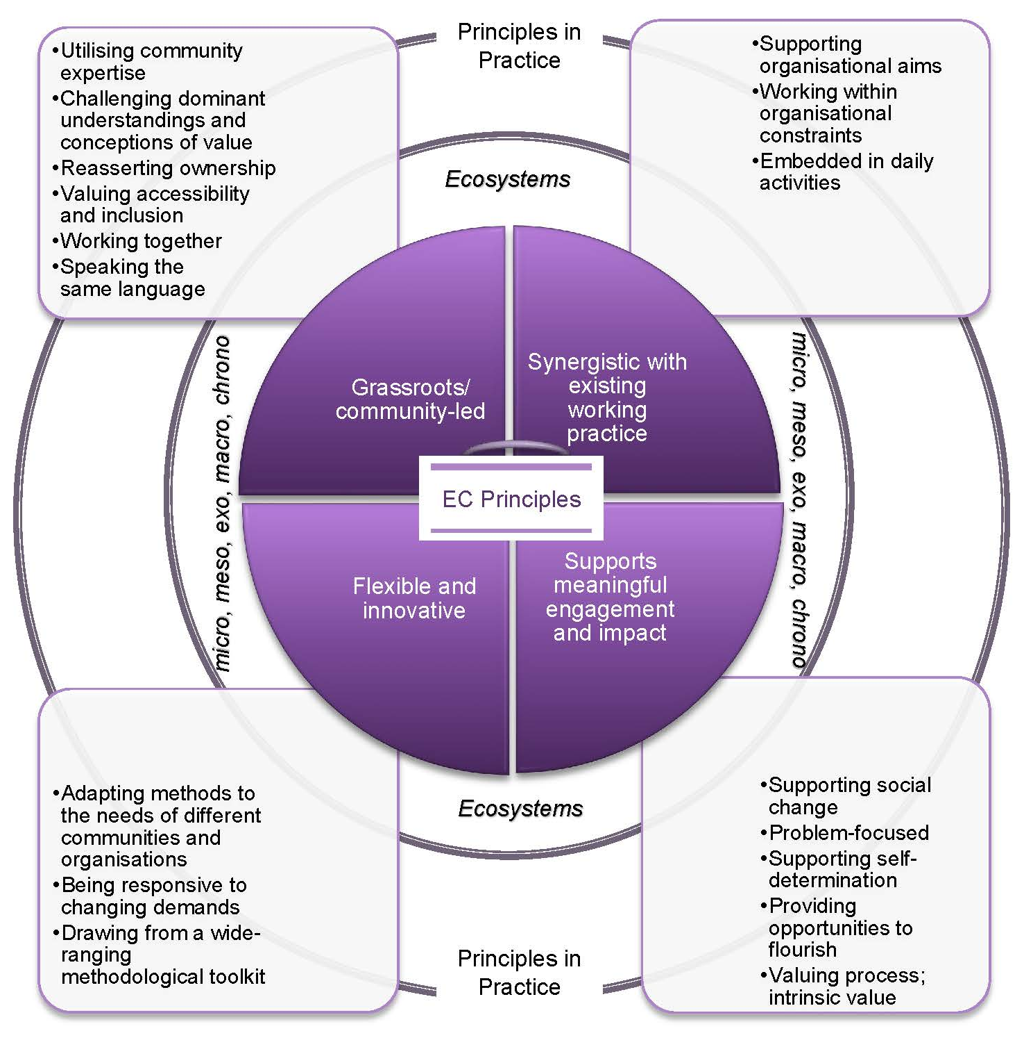
Notes:
Figure shows the core principles of the EC model, considering how these play out in practice to form a model for democratic community-engaged research. Principles drawn from EC frame each stage of the research from defining its focus, parameters and the systems within which it sits, through to dissemination and application. The research landscape itself is understood as contextualised within micro, meso, exo, macro and chrono ecosystems, drawing on Bronfenbrenner’s ecological systems theory.
Grassroots/community-led: Research should be designed, carried out and applied with the needs and concerns of communities at its heart throughout. Being truly community-centred means questioning established ways of working and the underlying basis for these. It also means being prepared to relinquish some power.
Synergistic with existing working practice: EC is about the kinds of creative activities that people choose to engage in as part of their normal, day-to-day lives. It meets needs that individuals have identified themselves, rather than seeking to fulfil an agenda imposed by an outside agency. Similarly, community-engaged research should meet need/s that community members recognise and respond to. In order to be practicable and effective, such research must also support organisational aims and work within their resource constraints.
Supports meaningful engagement and impact: Community-engaged research seeks to make a real difference to the communities at its heart. This means taking a practical, problem-focused approach that clearly identifies and supports meaningful social change. It is important that communities themselves are able to define what is meant by meaningful engagement and impact, and that they are supported to play an active role in determining their own futures.
Flexible and innovative: EC highlights innovation and flexibility. Having a wide range of different methods for data collection and analysis to draw on facilitates this flexibility. Creativity, in this context, means keeping an open mind, listening to communities and drawing on existing knowledge (and relationships) across different disciplines and sectors.

Slide 10
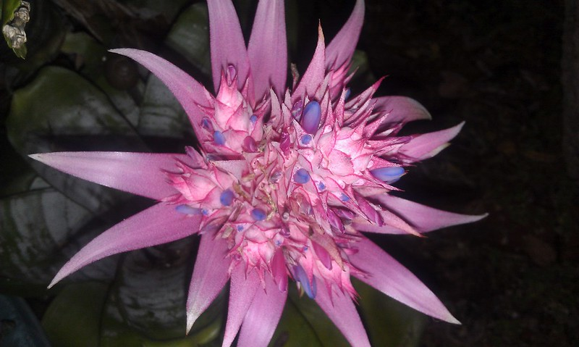
“Never doubt that a small group of thoughtful, committed citizens can change the world; indeed, it's the only thing that ever has.”
(Margaret Mead)
Image © osseous
Notes:
We argue that the application of these principles supports the democratisation of research and speaks to the social responsibility/service pillar of the tripartite model, by: centring community voices and grassroots practice; valuing experiential knowledge; and taking seriously accessibility, inclusion and power-sharing. In doing so, the model and resources seek to facilitate impactful research, valuing the strengths, skills and knowledge held within communities and community organisations, prioritising social change, and framing problems (and solutions) in terms of community need. Attending closely to existing practice and need within community organisations and considering the wider ecosystems within which they, and the communities they support, operate further supports the efficacy of this approach to community-engaged research.
Further notes:
It is important to note that the extent to which the pack and model are able to meet these aims is limited in practice by the flexibility of their application and the groups with whom they are used. They will support a democratisation and decolonisation agenda only to the extent that they are used with, by and for diverse groups that adequately represent the richness of diversity within wider communities of interest. Furthermore, the materials must be used responsively, with close attention to the changing needs and capacities of these groups. Finally, it is important to remember that change is often dependent upon the approval and resourcing of those organisations and structures that hold power within relevant interconnected ecosystems. The effective application of this model is likely to require some of these groups and organisations (including community organisations) to cede power to communities, which can be a difficult challenge to surmount. Nonetheless, we contend that the model presented in this paper represents an important step towards democratising research, with a view to achieving meaningful, impactful, and sustainable change.

Slide 11
Model and Resources
Johnson, H. and Monney, N. (under consideration) Towards Democratising Research: Lessons From Everyday Creativity.
Johnson, H. and Monney, N. (2024). Community Research Resource Pack. [Available online soon!]
Community-University Partnership Working
Johnson, H. and Monney, N. (2023). Interview in, Rhodes, E. When You Work in the Community, You See the Strengths, You See the Passion and Resilience. The Psychologist, pp. 42-45. Available at: https://www.bps.org.uk/psychologist/when-you-work-community-you-see-strengths-you-see-passions-and-resilience
Johnson, H. and Monney, N. (2021). Using the Arts to Support the Arts: A Creative, Community-University Partnership Approach to Building Arts Inclusivity in Economically-Deprived Communities. Forum: Qualitative Social Research, 22 (3): Art 2. https://doi.org/10.17169/fqs-22.3.3650
Everyday Creativity
AHRC Everyday Creativity Research Network: https://blogs.brighton.ac.uk/everydaycreativity/

Slide 12
Everyday Creativity: Celebrating Practice, Exploring Legacies & Forging New Paths Forwards
Conference of The AHRC Everyday Creativity Research Network and Creative Lives
Date: Thursday 26th September 2024
Location: Cecil Sharp House, London
Hosted by: The AHRC Everyday Creativity Research Network and Creative Lives
Registrations: https://www.creative-lives.org/Event/the-everyday-creativity-conference-2024
Notes:
Quick plug!

Slide 13
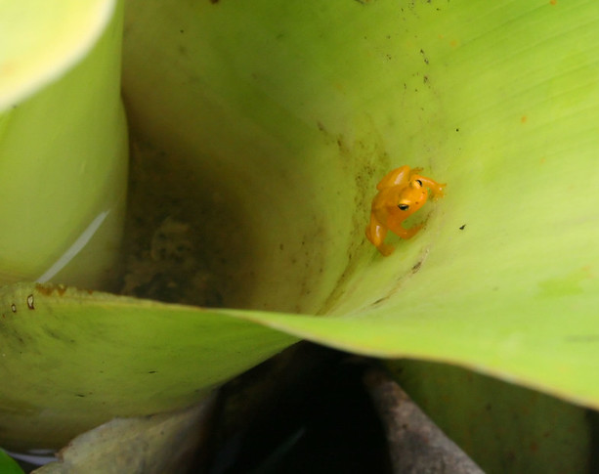
Questions?
Helen Johnson
Email: h.f.johnson@brighton.ac.uk
Personal website: https://www.helenjohnson.co.uk/
At University of Brighton: https://research.brighton.ac.uk/en/persons/helen-johnson
AHRC Everyday Creativity Research Network: https://blogs.brighton.ac.uk/everydaycreativity/
Image © Ian Mackenzie

