Slide 1
Insider or Outsider? Doing Research In and About Cultural Organisations
QUEST SEMINAR: BEING CREATIVE - RESEARCH AND COLLABORATION
Dr Laura Harris
University of Southampton
17th September 2025

Slide 2
SECTORAL CONTEXT OF ART GALLERIES
Private?
Public?

Slide 3
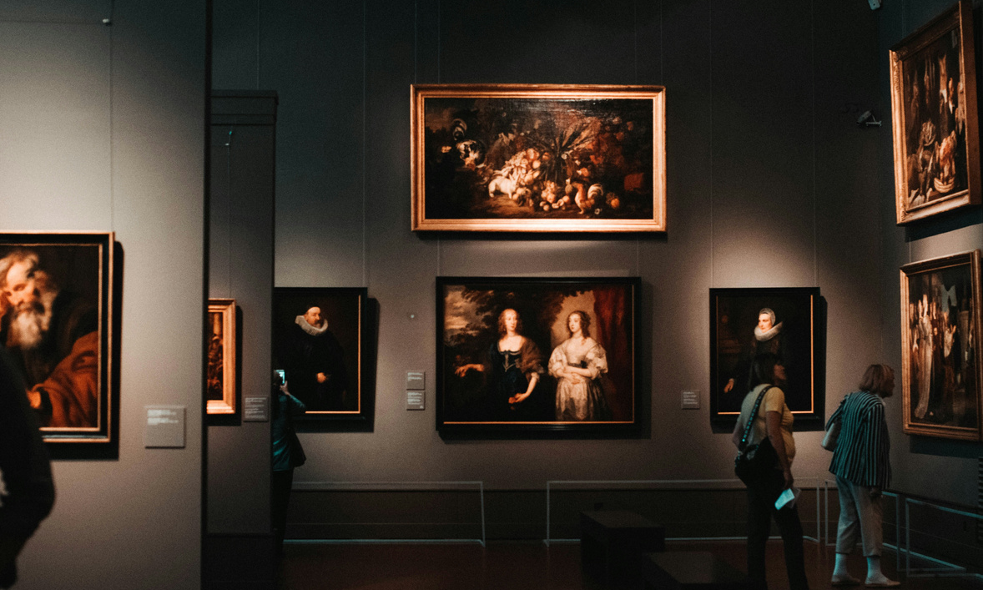
THE BROADER PICTURE
Mission statements
Funding discourse
Friends of Schemes
Business models
Publicness as evaluative code
Public function justifies public funding
Producing private experiences to create affinity and encourage philanthropy
Splitting operations between charity and for-profit
For example, Tate:
“Our mission is to increase the public’s enjoyment and understanding of British art from the sixteenth century to the present day and of international modern and contemporary art.”

Slide 4
THE CHALLENGE
Publicness as major organisational identity
Publicness as major staff motivation
Publicness as value in cultural discourse & policy
Privateness as imperative in business models given neoliberal cultural policy context
Relationship between privateness and arts’ elitist history
Where does this leave academic researchers?
Insiders or Outsiders?

Slide 5
OPPORTUNITIES AND CHALLENGES
Publicness
Self-curious and publicly committed to exploration and equality
Open to diverse knowledges
Creative dissemination opportunities
Expansive networks of practice
Privateness
Risk averse
Heavy gatekeeping (space and data)
Highly competitive job market
Low pay

Slide 6
THE SPACE BETWEEN
‘Holding membership in a group does not denote complete sameness within that group. Likewise, not being a member of a group does not denote complete difference’ (Dwyer & Buckle, 2009, p. 60)
‘A space between, a space of paradox, ambiguity, and ambivalence, as well as conjunction and disjunction’ (Dwyer & Buckle, 2009, p. 60).
Dwyer, S. C., & Buckle, J. L. (2009). The Space Between: On Being an Insider-Outsider in Qualitative Research. International Journal of Qualitative Methods, 8(1), 54-63. https://doi.org/10.1177/160940690900800105

Slide 9
CONCLUSION
Develop analysis of sectoral contexts
Institutional critique or shared goals?
Reflect on position in ‘space between’
Write fieldnotes about your collaboration - this is an object of research itself
BIBLIOGRAPHY
Dwyer, S. C., & Buckle, J. L. (2009). The Space Between: On Being an Insider-Outsider in Qualitative Research. International Journal of Qualitative Methods, 8(1), 54-63.
Harris, L. (2023). Private View? The Organisational Performance of ‘Privateness’ and ‘Publicness’ at an Art Gallery. Cultural Sociology, 0(0).

