Slide 1
How creative and multimodal methods can help researchers to theorise and design better research
Rachel Ayrton
University of Southampton
@RachelAyrton
Notes:
What I want to do is to push the boundaries a bit of where graphic methods fit in the full operation of research. We are comfortable with their application in the outward-facing aspects of research – that is, as research methods that engage with participants in creative and participatory ways, and in the communication and dissemination of research. But what about the more private aspects of research work – processes of conceptualisation, research design, or analysis? I am going to suggest that graphic methods are useful tools for researchers ourselves, not only participants and publics that we might seek to engage with our research. And I’m going to show you how this can work.
This work arises out of my attempts to operationalise a particular abstract, but important, concept – trust. I have used storyboarding as a way of pushing beyond the literature and my own literary-verbal argumentation in conceptualising trust and the associated activity of research design. I have used Bourdieu’s notions of the construction of the sociological object, reflexivity and habitus to help me along the way, and I’ll flag these tools as we come across them in practice. What I intend to argue is that visual and multimodal methods can achieve three very useful things:
Firstly, they can help to safeguard the relationship between theory and method by encouraging consistent attention to the construction of the object of research.
Secondly, they can speculatively reveal new facets of the object under investigation which may alter the way that that phenomenon is investigated empirically.
Thirdly, they support reflexive attention to the researcher’s relation to the object of research, and enable the researcher to identify and transcend the limitations that this may impose.
These three capabilities, I suggest, have the potential to improve the quality and rigor in research.

Slide 2
Outline
Positioning visual/multimodal methods in the social scientific research process
Theoretical foundations for applications of visual/multimodal methods in conceptualisation and operationalisation
A worked example: introducing trust
Methodology
Storyboarding in practice – three trust scenarios
Reflexivity and the author’s habitus
Capabilities and mechanisms of visual/multimodal methods
Why not visual/multimodal methods for theorising?
Notes:
Positioning visual/multimodal methods in the research process – where they are used, by whom, and where are the boundaries to their application?
Methodological foundations for the use of visual/multimodal methods in conceptual work and research design
I’ll introduce the concept of trust. Using Bourdieu’s notion of the construction of the sociological object I’ll outline both the dominant approaches to trust research and the process approach to trust that I favour.
I’ll explain what exactly I did, before
Showing you the three worked examples of storyboarding that I produced with a visual artist, and talking through the learning that emerged from this process.
I’ll then draw on my reflections on the practice of storyboarding, using Bourdieu’s notions of reflexivity and habitus,
Before summarising what I have found to be the capabilities of visual/multimodal methods for the pre-empirical processes of conceptualisation and operationalisation. I will also point out the mechanisms that I think are at play, which make the use of visual/multimodal methods distinct to the more usual academic approach of literary-verbal argumentation.
I’ll finish with a brief thought about the implications of the divide between methods presumed to be suitable for researchers and those that are appropriate for research participants and audiences.

Slide 3
Visual and multimodal methods in the social science research process
Vast array of visual/creative products
Vast array of visual/creative products
Conceptual diagrams
Graphs, figures, maps
VISUAL PRODUCTS
Conceptualisation
Research design
Data collection
Analysis
Presentation
Dissemination
< Operationalisation >
INWARD-FACING
OUTWARD-FACING
INWARD-FACING
OUTWARD-FACING
Notes:
Begin by looking at the research process. This illustration is a crude in preventing a rather simplistic and misleadingly linear picture, but what it seeks to convey is that there are different practices within the process of research. Some of these practices are inward-facing, that is, they are either private to the researcher or a limited audience of academics. Others are outward-facing, that is, they are oriented towards wider publics which may include mixed or predominantly non-academic audiences, such as research participants or users.
A range of visual products may be used in different actions of research, but in the inward-facing activities these tend to take on a more limited and particular form. I’ll explore this in more detail …

Slide 4
Visual and multimodal methods in the research process: a closer look
Privilege of language in knowledge production (Richardson 1994; Grenfell and Hardy 2007; Eisner 2008)
Legitimate locations and forms for the visual:
Visualisations in social scientific theoretical frameworks (Grady 2006; Wagner 2006)
“rhetorical mathematics … modes of representation that act as emblems of scientific authority” (Lynch 1991: 18)
Creative and participatory approaches to data collection
Mapping, sorting and ranking; photovoice; community-based participatory video; participatory theatre; drawing and other ‘handmade’ or folk art techniques
Similar distinction between other inward-facing and outward-facing aspects of research
The cultural goods that are produced and consumed in the social scientific field are valued differently as products of properly academic practice.
Notes:
The notion that language constitutes a privileged form of knowing in Western culture requires little defence. Philosophers from Plato to David Hume have advised a distrust of sensory perceptions, leading to the Kantian proposition that the ideas of the mind are the only basis for objective knowledge, and language provides a mode in which that rational thought can be expressed. In the Enlightenment a division solidified between literary (fictive) and scientific (fact) writing, in line with a more general privileging of science over art. As a result the positivist tradition that emerged favoured propositional forms that could be (philosophically or scientifically) verified or falsified. In the contemporary social scientific field, conventional forms continue to be prescribed – such as systems of referencing, linear narratives, the distillation of an argument into an abstract and the labelling with key words – and these hold considerable material and symbolic power (Richardson, 1994).
Since the “visual turn” in the social sciences (Jewitt 2008) there has been an expansion of legitimate uses for visualisations in research. However, I suggest, the full range of forms this might take have not diffused evenly across the processes of research. This is exemplified through a comparison between the conceptual diagrams that are commonly found in theoretical frameworks in the inward-facing orientations of social research, and the products of creative and participatory approaches to data collection in an outward-facing mode.
Visualisations are routinely used in the construction of social scientific theoretical frameworks. Ordinarily, these visualisations encompass a very restricted range of ‘cultural goods’ (Bourdieu, 1984 [1979]), such as flowcharts, checklists, figures and tables (Grady, 2006; Wagner, 2006). In some cases, these are accompanied by paralleled textual description that renders them according to Michael Lynch “a picture of nothing with no distinctive role in the text” (Lynch, 1991, p. 6). He has observed in the common features of social theoretical visualisations, including bounded labels, quasi-causal vectors, and spatial symmetries, a “rhetorical mathematics” which operates through employing “modes of representation that act as emblems of scientific authority” (Lynch, 1991, p. 18). In the pre-empirical stages of conceptualisation and research design, social thought has as yet made very limited use of the range of visual forms available.
In data collection, however, and in particular within the field of participative methodologies, a diverse array of visual/creative practices are legitimately used, including mapping, sorting and ranking exercises (Rietbergen-McCracken and Narayan, 1998), photovoice (Wang and Burris, 1997; Evans-Agnew and Rosemberg, 2016), community-based participatory video (Chávez et al., 2004; Mitchell and de Lange, 2011), participatory theatre (Kaptani and Yuval-Davis, 2008; Abah et al., 2009), and drawing or other ‘handmade’ or folk art techniques (Anderson and Gold, 1998; Feen-Calligan et al., 2009; Theron et al., 2011).
Wide range of methods used, but only in certain places, with a distinction between what forms are legitimate in inward- and outward-facing aspects of research. This leads me to conclude that the cultural goods that are produced and consumed in the social scientific field are valued differently as products of properly academic practice.

Slide 5
Theoretical foundations for the use of visual/multimodal methods in conceptual work and research design
Visualisations inform the thinking of the producer(s) (Grady 2006; Tufte 2006; McNiff 2008)
Unexpected results
Revealing associations
Portrayal of complexity
Artistic products enable knowing in their own right (Graham 2005)
Process of production enables inspiration (Eisner 2008; Jacobsen et al. 2014)
“A shift in methodology can bring tremendous insight and relief … the use of our hands, bodies, and other senses as well as the activation of dormant dimensions of the mind, may offer ways of solving and re-visioning problems that are simply not possible through descriptive and linear language.” (McNiff 2008: 33)
Notes:
We might very reasonably tend to assume that the formal kinds of literary-verbal argumentation that are commonly the currency of academic thought are sufficient for our needs when working inwardly, for example in conceptualising and operationalising phenomena. These are, after all, for many of us, our skills set! However, if we turn to the literature on visual and arts-based methods, we get a really very promising impression of the potential that these alternative methods might have for theory and research design:
Proponents of visual or arts-based methods assert that visualisations should not only inform the audience, but also the thinking of the producer(s): generating unexpected results, revealing associations not otherwise evident, and enabling the portrayal of complexity (Grady, 2006; Tufte, 2006; McNiff, 2008). Artistic products may legitimately enable knowing in their own right (Graham, 2005); however, the process of production is also fruitful, as stepping beyond one’s habitual ways of working can be a source of inspiration and a fresh perspective (Eisner, 2008; Jacobsen et al., 2014). As Shaun McNiff has observed,
“A shift in methodology can bring tremendous insight and relief … the use of our hands, bodies, and other senses as well as the activation of dormant dimensions of the mind, may offer ways of solving and re-visioning problems that are simply not possible through descriptive and linear language.” (McNiff, 2008, p. 33)

Slide 6
Lacks an agreed-upon definition
An example: trust research
Prone to collapses into preconstructions
Not yet mature as an academic field
Non-material, abstract
The construction of the object of research: “No doubt the most crucial research operation and yet the most completely ignored.” (Bourdieu & Wacquant 1992:224).
A “protracted and exacting task that is accomplished little by little” through the continuous engagement of theory and method in research (Bourdieu & Wacquant 1992:227-8)
The alternative: passive adoption of ‘pre-constructed objects’; methodological assumptions regarding what counts as evidence are a symptom of this (Bourdieu & Wacquant 1992:230).
Notes:
So now we’ll turn to my worked example to see what happens when visual or multimodal methods are directed towards the construction of the object in the conceptualisation and operationalisation of trust.
Trust research is a good field in which to try out the implications of these possibilities for the visual. Trust lacks an agreed-upon definition, and the interdisciplinary field that seeks to apply the concept is still relatively immature. It is a non-material, abstract concepts which makes it less obvious how to approach the practice of visualisation, and it is a concept which is particularly prone to collapse into preconstructions – now what do I mean by that?
For Bourdieu, the construction of the object of research is the most crucial, and neglected, operation of research.
It is an exacting task that requires continuous engagement of theory and method in every action of research to ensure that the two remain integrated.
One of the adverse consequences for research if the construction of the object is not given enough attention is in lapses to preconstructions – that is, dominant conceptions of the phenomenon that already circulate.

Slide 7
Preconstructions of trust
Trust as attitude
Trust is exercised in a tri-part relation where “A trusts B to do, or with respect to, X.” (Hardin 2006, p.19)
Rational assessment based on encapsulated interest - “the trusted encapsulates the interest of the truster and therefore has incentive to be trustworthy in fulfilling the truster’s trust.” (Hardin 2002:24)
Methodology: attitudinal surveys
BUT
“Good reasons” do not always produce trust.
There is no automatic logic between trusting attitudes and trusting behaviour
(Möllering 2001)
Trust as behaviour
Trust requires commitment through action – ‘betting on’ someone (Sztompka 1999)
Distinction between ‘trust as attitude’ and ‘trust as choice’ – a behavioural decision to accept vulnerability (Li 2007, 2012)
Methodology: trust games

Slide 8
A process approach to trust
Drawing on Möllering 2001, 2006; & Dietz 2011
The context: vulnerability and uncertainty
Interpretation
Suspension – the ‘leap of faith’
Favourable expectation
Evaluation/feedback
Methodology – difficult to operationalise, but interpretive, in-depth qualitative approaches most likely to be suitable
BUT non-standardised instruments more likely to invite conceptual lapses …
Notes:
A more promising approach is that outlined particularly by Guido Mollering. It is generally agreed that trust takes place in the context of vulnerability and uncertainty. The process begins with interpretation – outlining the good reasons one might have to trust and distrust. The outcome of trust is to reach a state of favourable expectation regarding the outcome of action you might take that involves dependence on another social actor (a person, a group of people, an institution …). To traverse the void between interpretation and a state of favourable expectation, involves what Mollering calls suspension – a kind of “leap of faith” that “brackets out uncertainty and ignorance, thus making the interpretative knowledge gained through interpretation momentarily ‘certain’” (Mollering 2001). Graham Dietz suggests that there is a feedback loop from past experiences that inform future trust dilemmas.

Slide 9
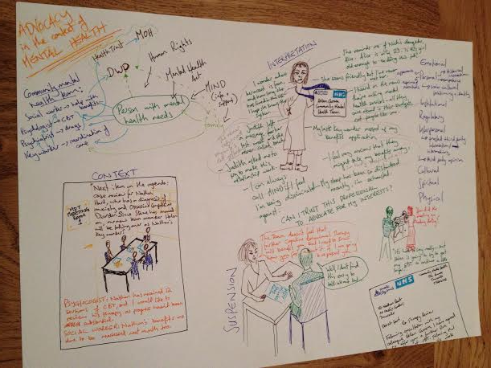
Methodology
Storyboarding
Multimodal – interplay between visual and verbal to communicate meaning and offer abstract or expressive details (McCloud 1993; Jewitt 2008; Mitchell et al. 2011)
‘Sequential art’ – “juxtaposed pictorial and other images in deliberate sequence, intended to convey information and/or to produce an aesthetic response in the viewer” (McCloud 1993: 9)
Usual application in community-based participatory video – an intermediate art form (Mitchell et al. 2011; Labacher et al. 2012)
The process:
Three imagined scenarios …
Annotated drawings
Involvement of a visual artist
Notes:
In order to explore trust in a creative mode, I made use of storyboarding. This technique provides a bridge between the static visual art of drawing, the dynamic art of film, and the textual art of narrative fiction, harnessing the potential of these forms for the imaginative telling of sociologically significant stories (Graham, 2005; Drake, 2014; Klorer, 2014). It is multi-modal, in that it interdependently incorporates both text and image, giving freedom where one mode sufficiently communicates meaning for the other to take on a greater level of abstraction or expression (McCloud, 1993; Jewitt, 2008; Mitchell et al., 2011a). It is related to cartoons, comics or graphic novels, which Scott McCloud generalises under the term ‘Sequential art’, which uses sequenced images to convey information and/or to produce an aesthetic response in the viewer. I favour the term storyboarding due to its status as an intermediate art form in participatory video methods (or film-making more generally) which echoes my use of the technique as a mediator between conceptual and empirical stages of the research process (Mitchell et al., 2011a; Labacher et al., 2012).
I chose three imagined scenarios, deliberately very different to each other, but where in each case the levels of uncertainty and vulnerability were high, to make trust extremely relevant.
I produced basic pencil and pen drawings of each scenario, reflectively annotating them on a larger piece of paper. Alongside the artistic process, I kept separate notes reflecting on the process. I then shared the annotated storyboards with a visual artist, Jo Le Prevost, and we discussed the theoretical ideas they contain. Jo replicated my storyboards faithfully in relation to the visual and verbal content as well as the expressive intent. The balance between realism and a more abstract, informal style that is appropriate to the wide-ranging scenarios depicted is one of the ways that her artistic interpretation shone through in the finished storyboards.

Slide 10
Questions of skill and status
How much skill is required?
Participatory research methods – participants actively encouraged to put aside questions of skill (Gauntlett 2007; Theron et al. 2011)
Arts-based research – spectrum from criticism of “amateur” or “inferior” attempts that appear to “mock” the artistic domain (Eisner 2008; Piirto 2002), to the pragmatic view that it depends on the purpose of the visual/artistic medium (Sinner et al. 2006; Pauwels 2015)
What is the status of the resulting visualisations?
Not data
No referent in the real world – the referent is conceptual
A heuristic device – “sociologically-informed speculative scenarios” (Jacobsen et al. 2014: 12)
Notes:
There are two questions that people commonly ask me about this approach which I will just flag here, around how much skill is required, and the status of the visualisations – that is, are they data? There isn’t time to discuss this in full, and we can return to this in questions if you like, but I will just note that I take the pragmatic view that the level of skill depends on the purpose of the visual/artistic medium in its particular application, and that I do not consider these visualisations to be data. They are the equivalent of pre-empirical verbal argumentation, but in a different, more imaginative form.

Slide 11
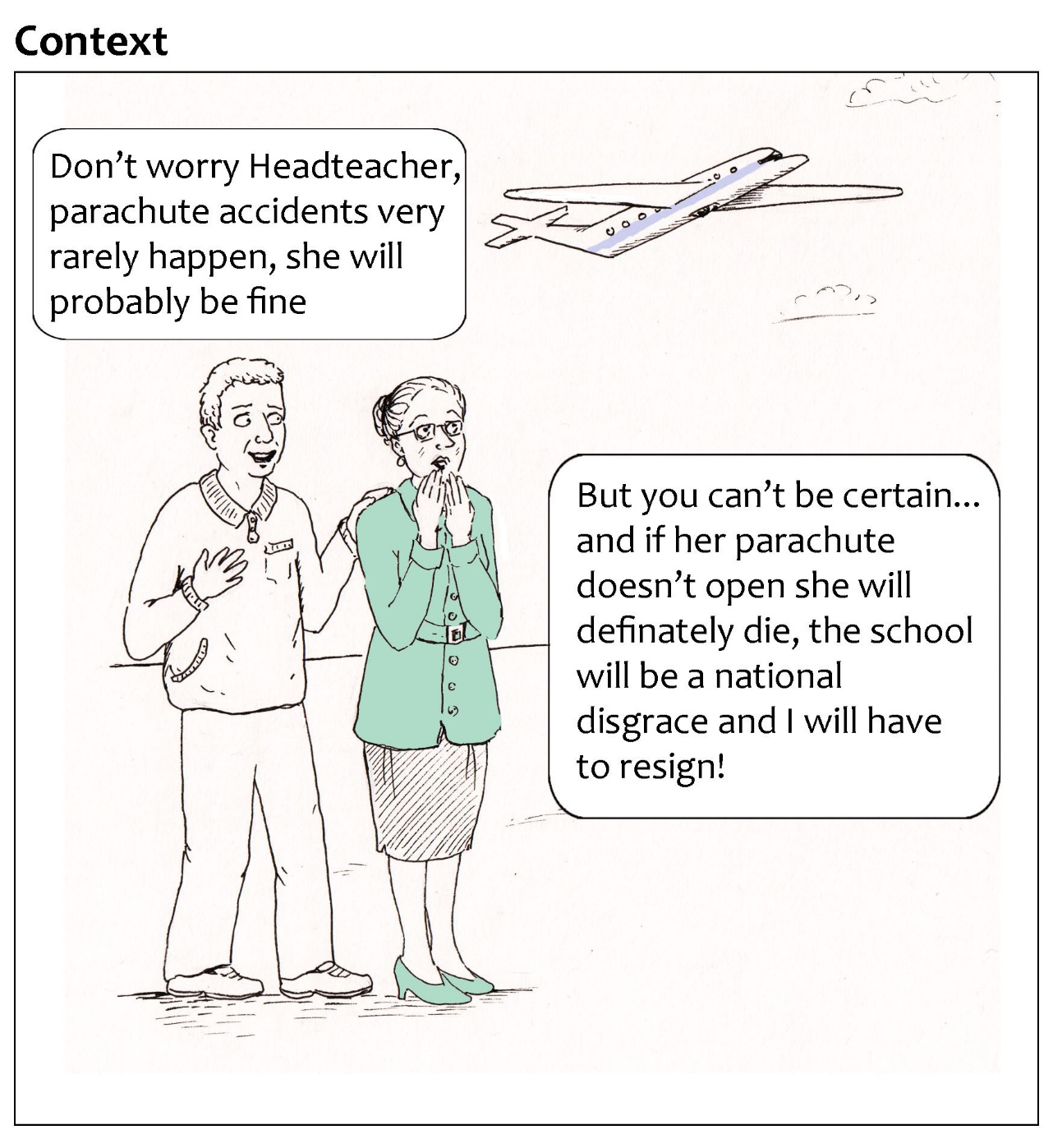
The PTA Parachute Jump
Scenario 1: The complexity of trust relations in context
Illustrations by Rachel Ayrton & Jo Le Prevost
Notes:
The first scenario focuses on of a mother, Julie, undertaking a charity parachute jump to raise funds for the Parents’ and Teachers’ Association (PTA) at her daughter’s school. The focus is on Julie’s trust in Instructor Joe of MEGA PARACHUTES to ensure her safety.
The context is one of high vulnerability, with Julie’s life in jeopardy as well as the potential for serious repercussions for the school and others associated with it; however, the level of uncertainty is low: it is highly unlikely that Instructor Joe will act negligently or maliciously.

Slide 12
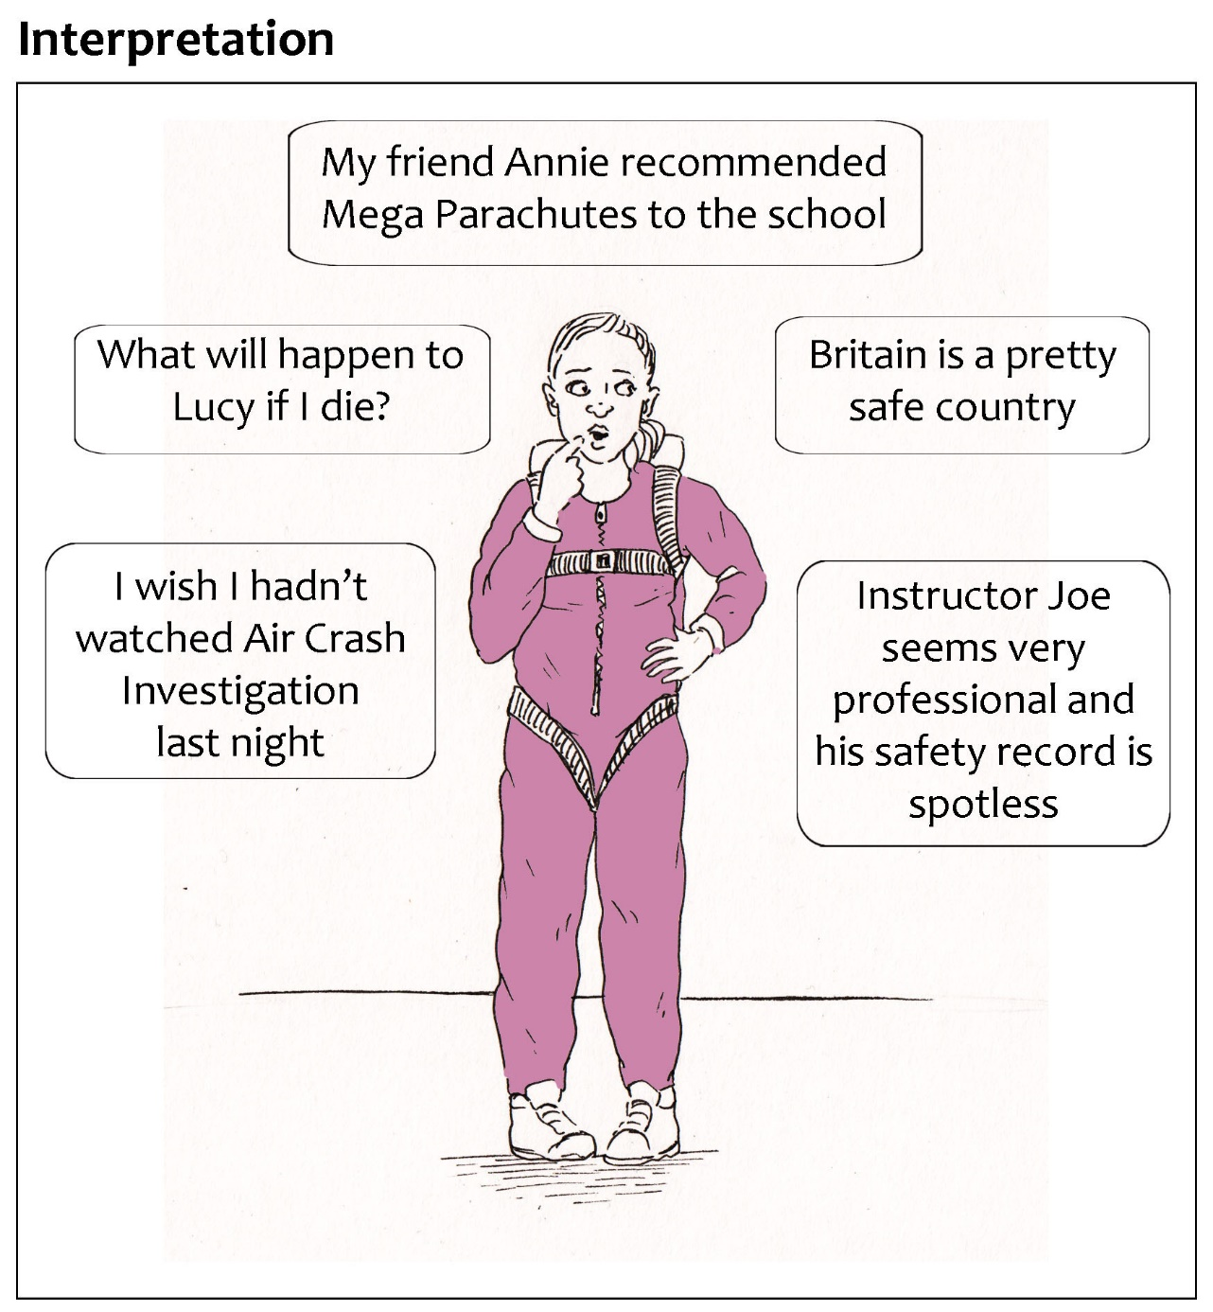
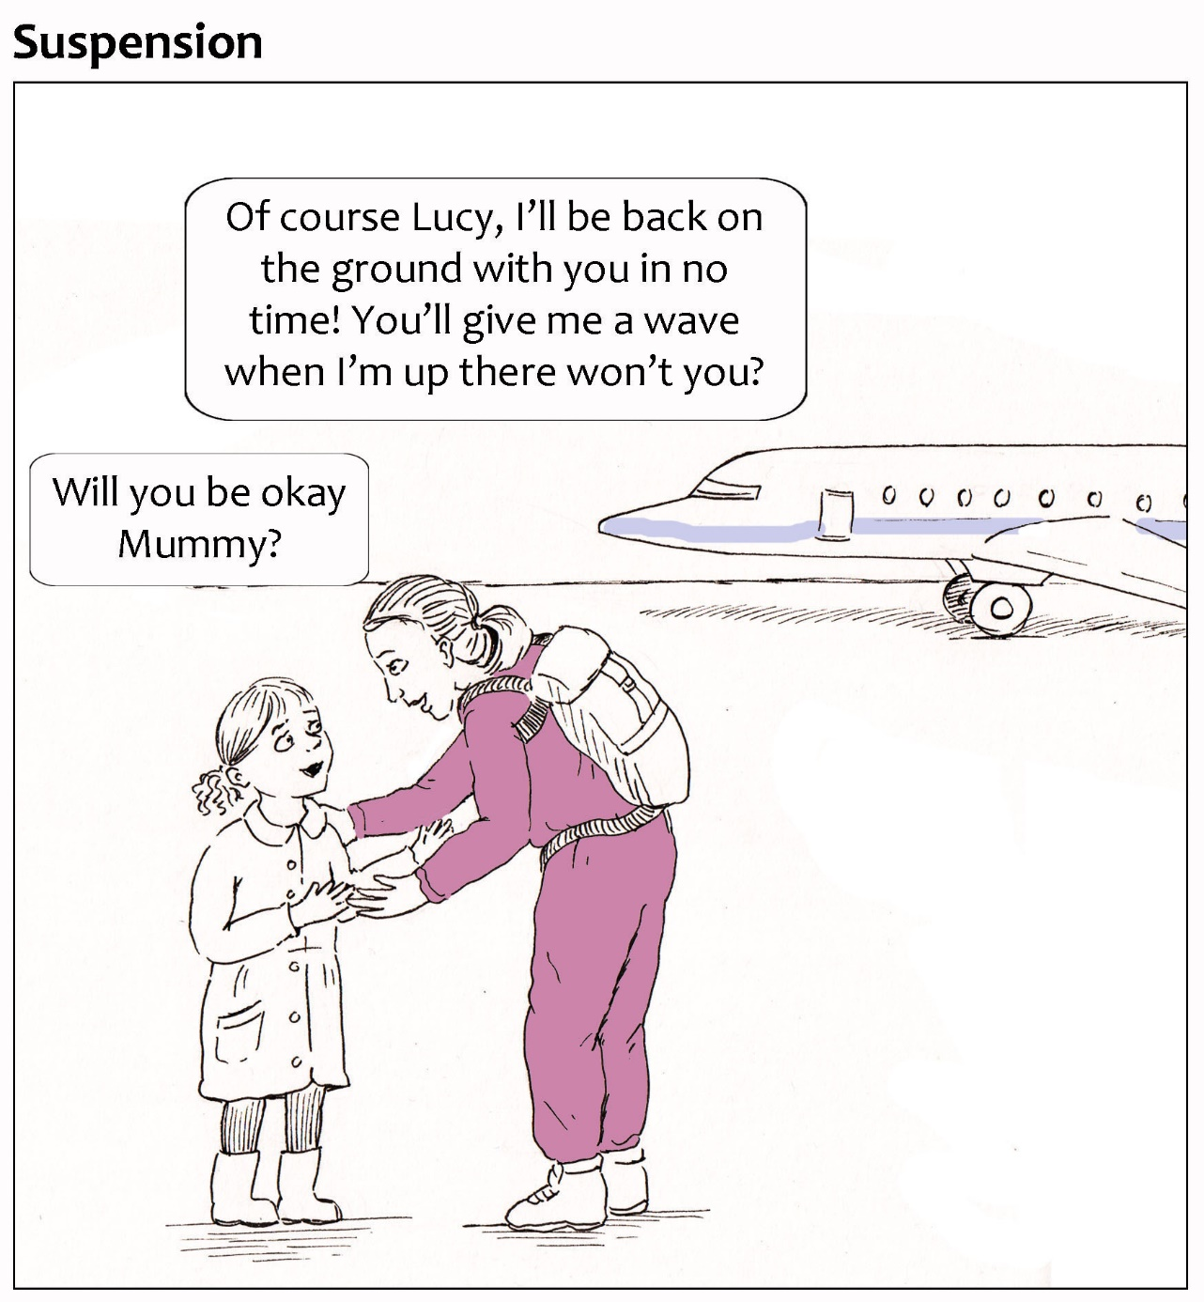
Scenario 1: The complexity of trust relations in context
Notes:
In her process of interpretation, Julie exercises judgment with reference to her personal impression of Instructor Joe and knowledge of his credentials. She also considers the national-structural context and (implicitly) safeguards in place, as well as relying on her trust in a third party intermediary. However, her daughter’s dependency on her is at the forefront of her mind and this concern and responsibility heightens the anxiety that naturally results from her vulnerability. She is also impacted emotionally by her cultural environment: in this case, her consumption of television programmes that affect her judgement of aviation safety. Although uncertainty remains, in the moment of suspension Julie brackets it out as she reassures Lucy in earnest that the outcome will be favourable.

Slide 13
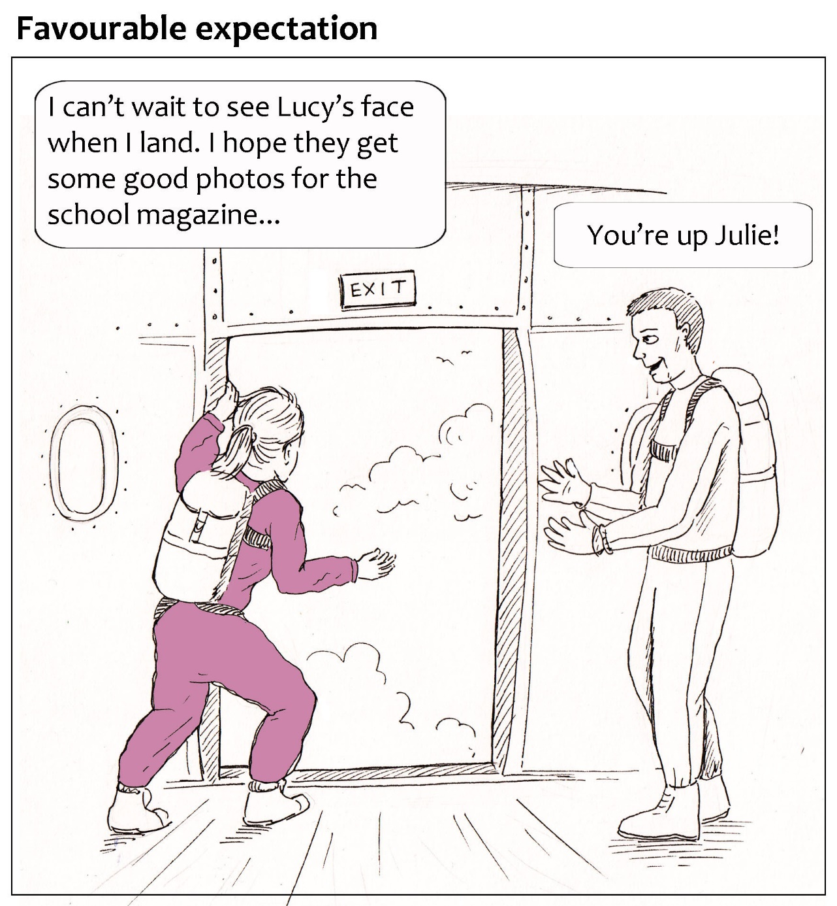
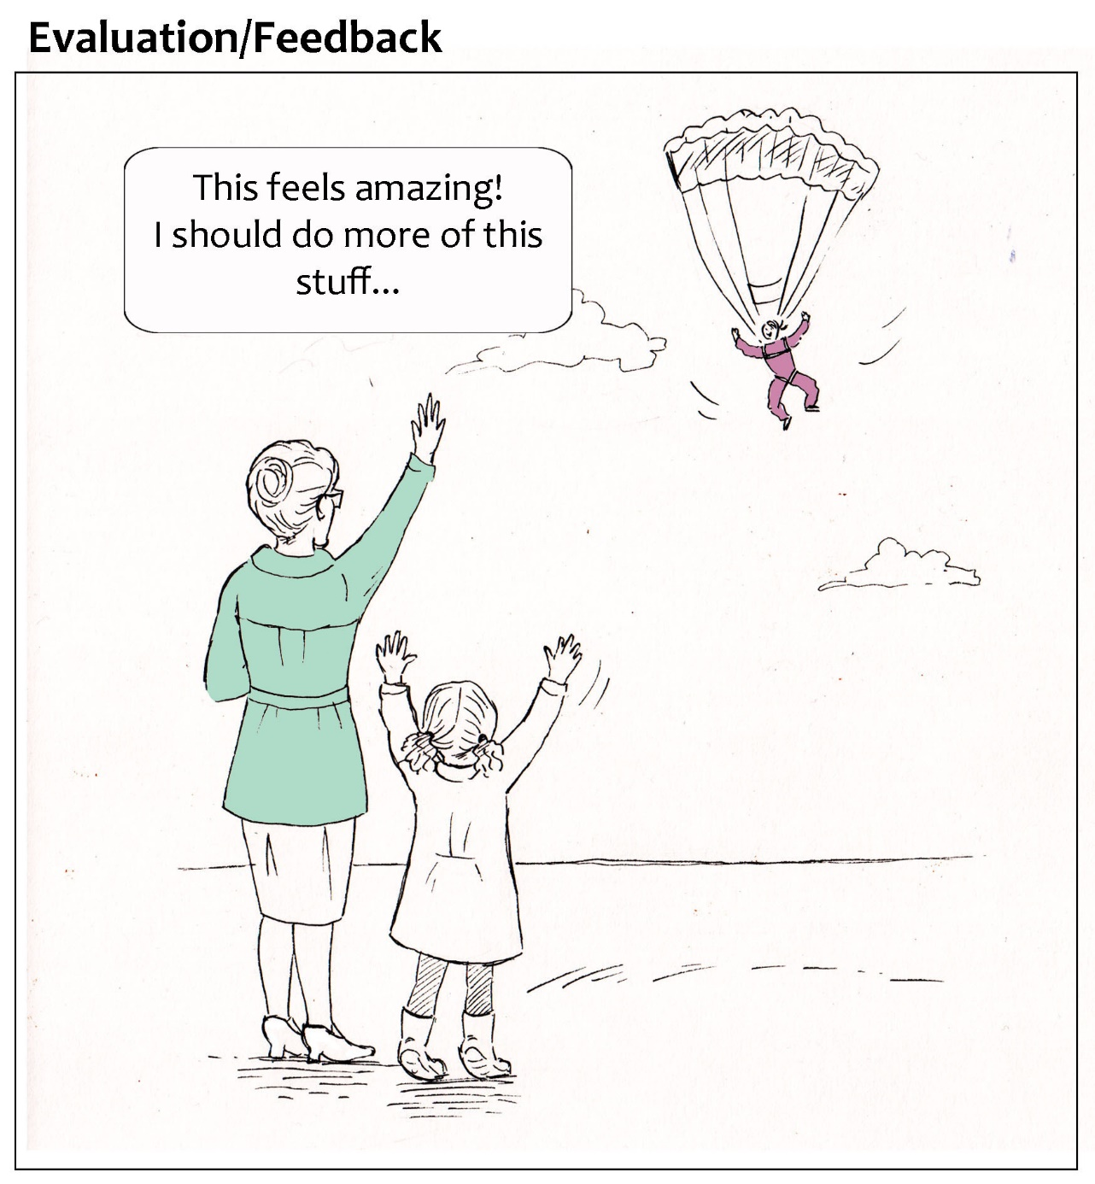
Scenario 1: The complexity of trust relations in context
Notes:
She is able to act with the expectation that all will be well, and as she experiences the exhilaration of the jump, she forms a memory that would (consciously or otherwise) inform future dilemmas as to whether to engage in extreme aerial sports.

Slide 14
Scenario 1: The complexity of trust relations in context
NATIONAL ASSOCIATION OF HEAD TEACHERS
PROFESSIONAL TRAINING
BRITISH PARACHUTE ASSOCIATION
Revealing preconstrutions
Inadvertently referring to individualised assumptions of ‘trust as attitude’ in attempt to operationalise trust
Focal dyad inseparable from the relational, institutional and cultural context in which it is situated.
A relational approach focusing on the trust dilemma as the unit of analysis
Headteacher
Instructor Joe
Julie
Lucy
MEGA PARACHUTES
CHARITY LAW AND GOOD PRACTICE
Parents, including PTA and governors
Lucy’s friends and peers
INSURANCE
LEGAL FRAMEWORKS
FOXLEASE SCHOOL
AUDIT (OFSTED)

Slide 15
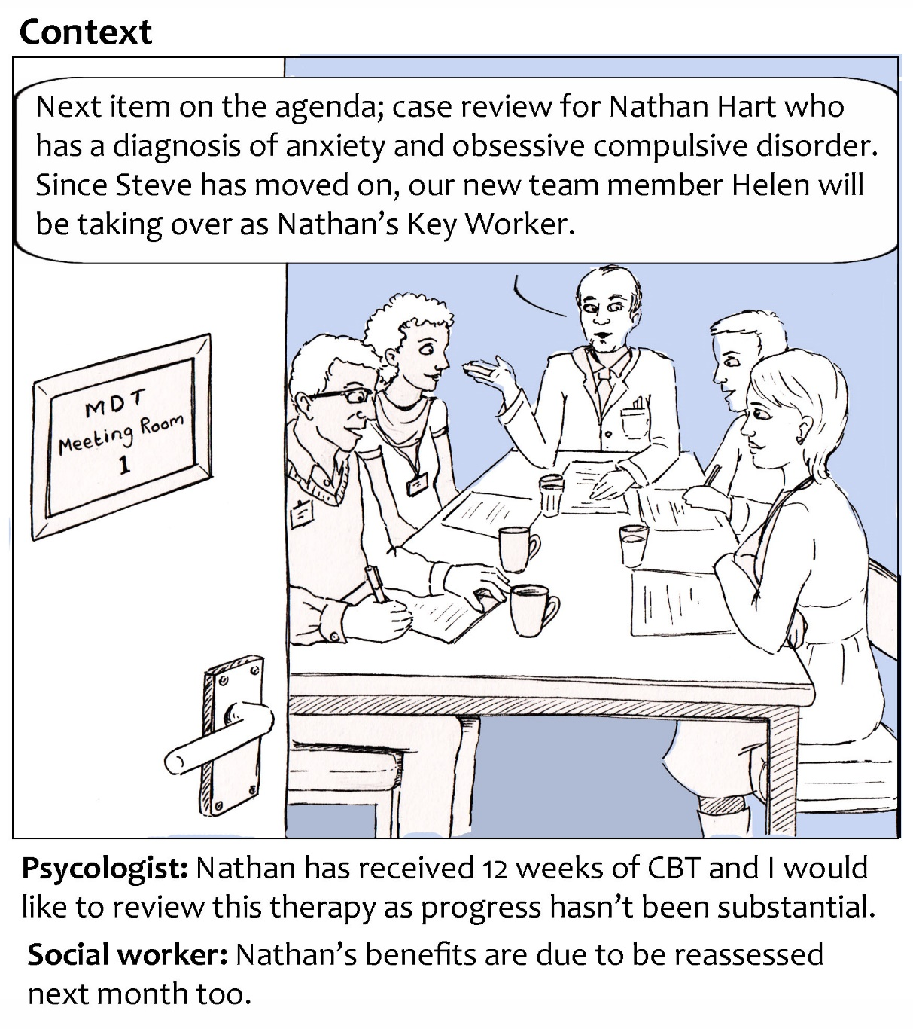
Trust in the context of mental health advocacy
Scenario 2: The bases of interpretation and rethinking institutional trust
Illustrations by Rachel Ayrton & Jo Le Prevost
Notes:
The second scenario considers advocacy in the context of mental health, and arose through discussion with a friend who has significant personal experience in similar contexts. It depicts Nathan, and his trust in a new keyworker, Helen, to advocate on his behalf.

Slide 16
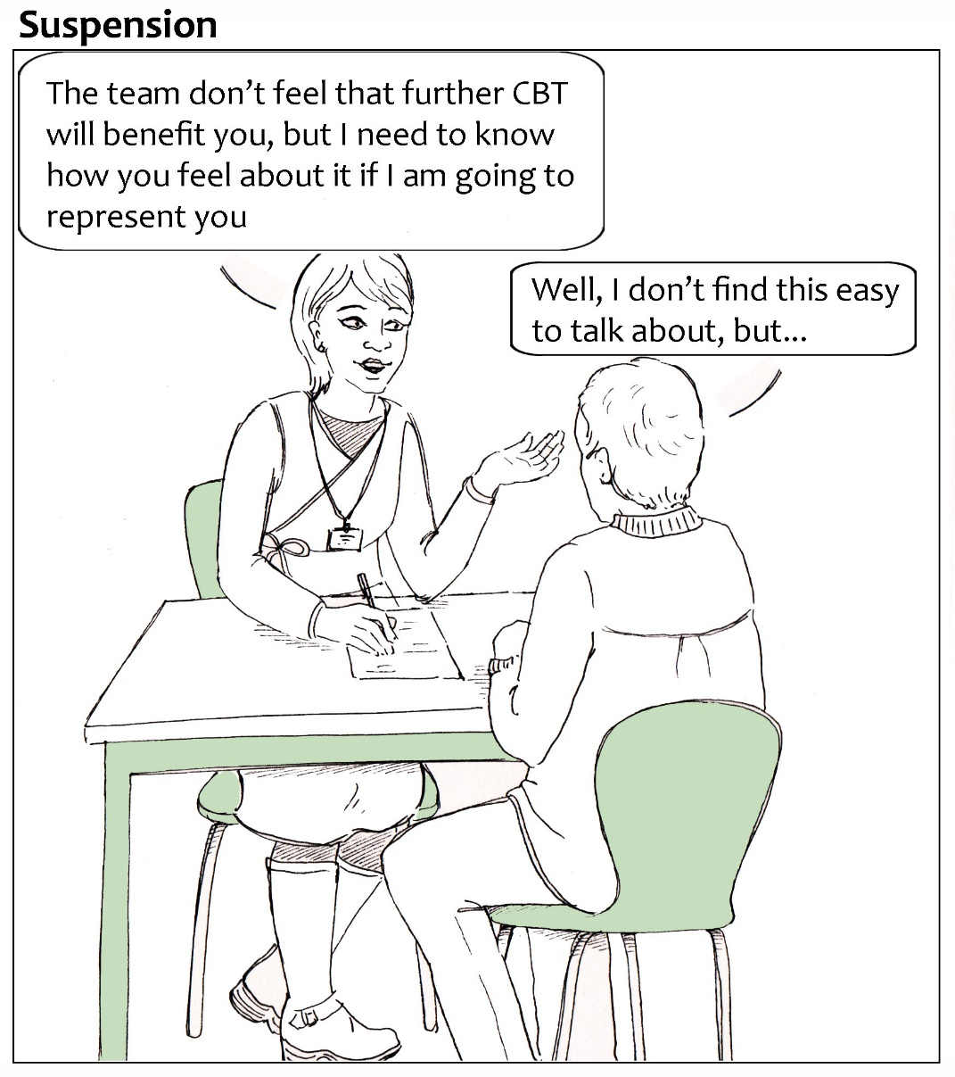
Scenario 2: The bases of interpretation and rethinking institutional trust
Notes:
Nathan’s process of interpretation is complicated by personal impressions of Helen being combined with her institutional affiliations and her professional group identification, as well as seemingly extraneous aspects of his circumstances and wellbeing which enter into his judgement. Nathan’s leap of faith is to suspend his reticence and confide in this near-stranger, believing that she will be assertive on his behalf, even as a newcomer in an established professional team.

Slide 17
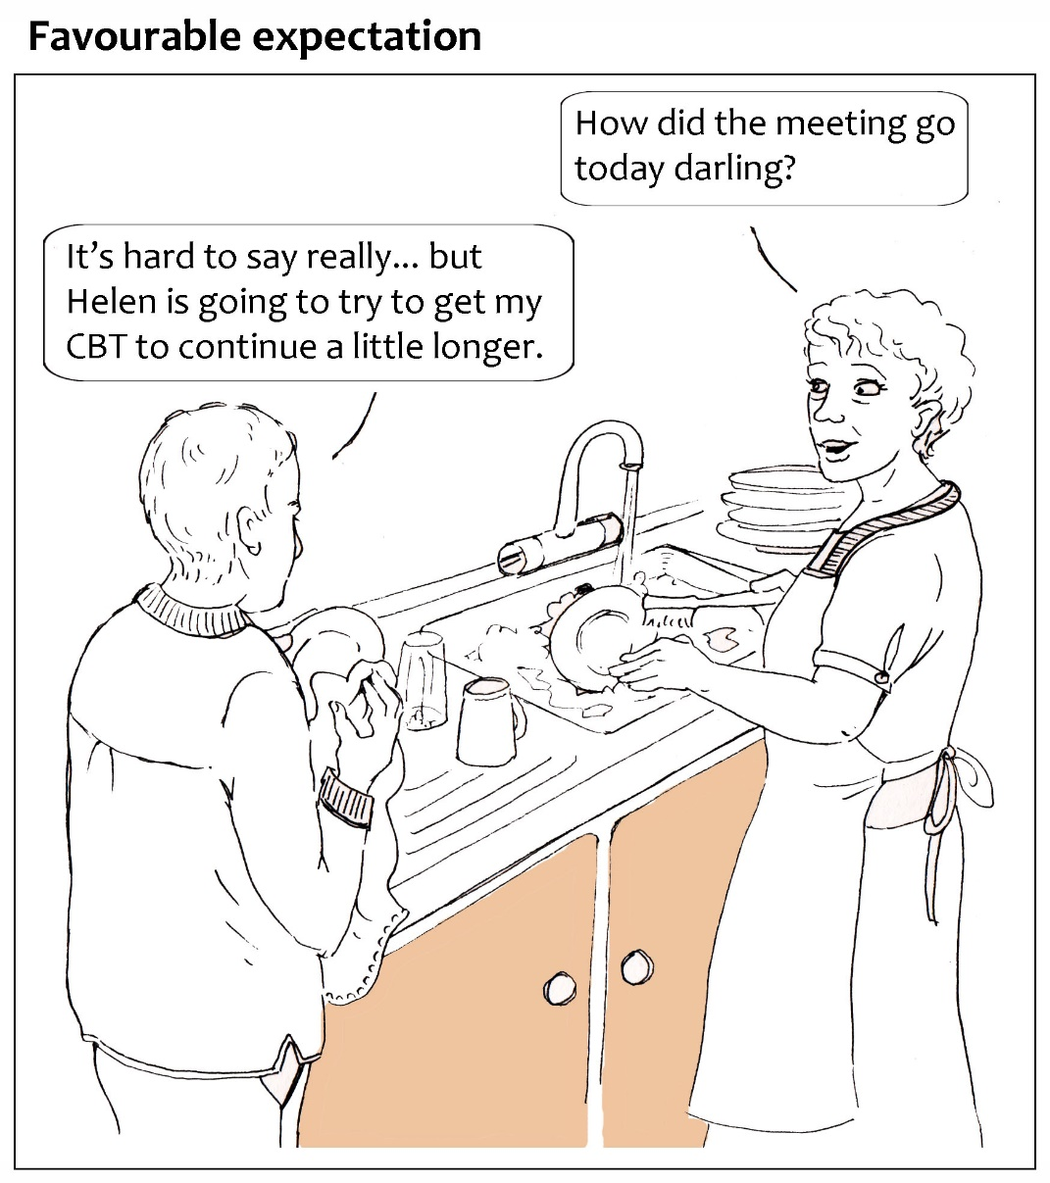
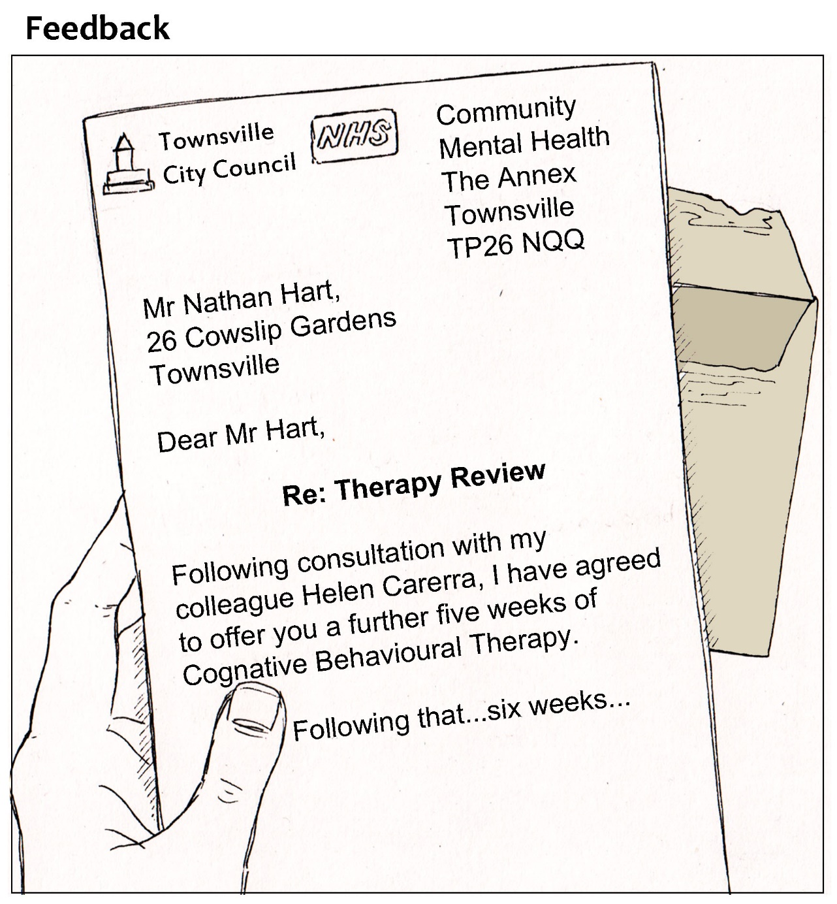
Scenario 2: The bases of interpretation and rethinking institutional trust
Notes:
Nathan’s favourable expectation is given a boost when Helen has an early success in securing an extension to Nathan’s therapy, and this is likely to be a consideration in the building of trust going forward.

Slide 18
Scenario 2: The bases of interpretation and rethinking institutional trust
Sources for interpretation
Personal
Historical interaction
Competence evaluations
Appearance
Socio-cultural positioning and identity
Institutional affiliations
Regulatory context
Emotional
Interpersonal
Trusted third party intervention/intermediary
Third party opinion
Cultural
Spiritual
Physical
Notes:
The bases of interpretation particularly struck me in this scenario. In particular, I became conscious of the temptation to focus excessively on cognitive or ‘rational’ reasons to trust, whereas in reality a range of physical, emotional, cultural and physical factors are likely to come into play as well. Further, I began to question the common distinction in trust research between institutional, identity-based and personalised forms of trust. The device of perspective places Helen’s name badge in the foreground, and suggests how her professional role and institutional affiliations mediate the personal relationship between the two. Further, Nathan is likely to have had sustained historical interaction with the agencies Helen represents, which calls into question whether institutional trust can really be considered ‘relationship free’, as it is commonly positioned in trust literature.

Slide 19
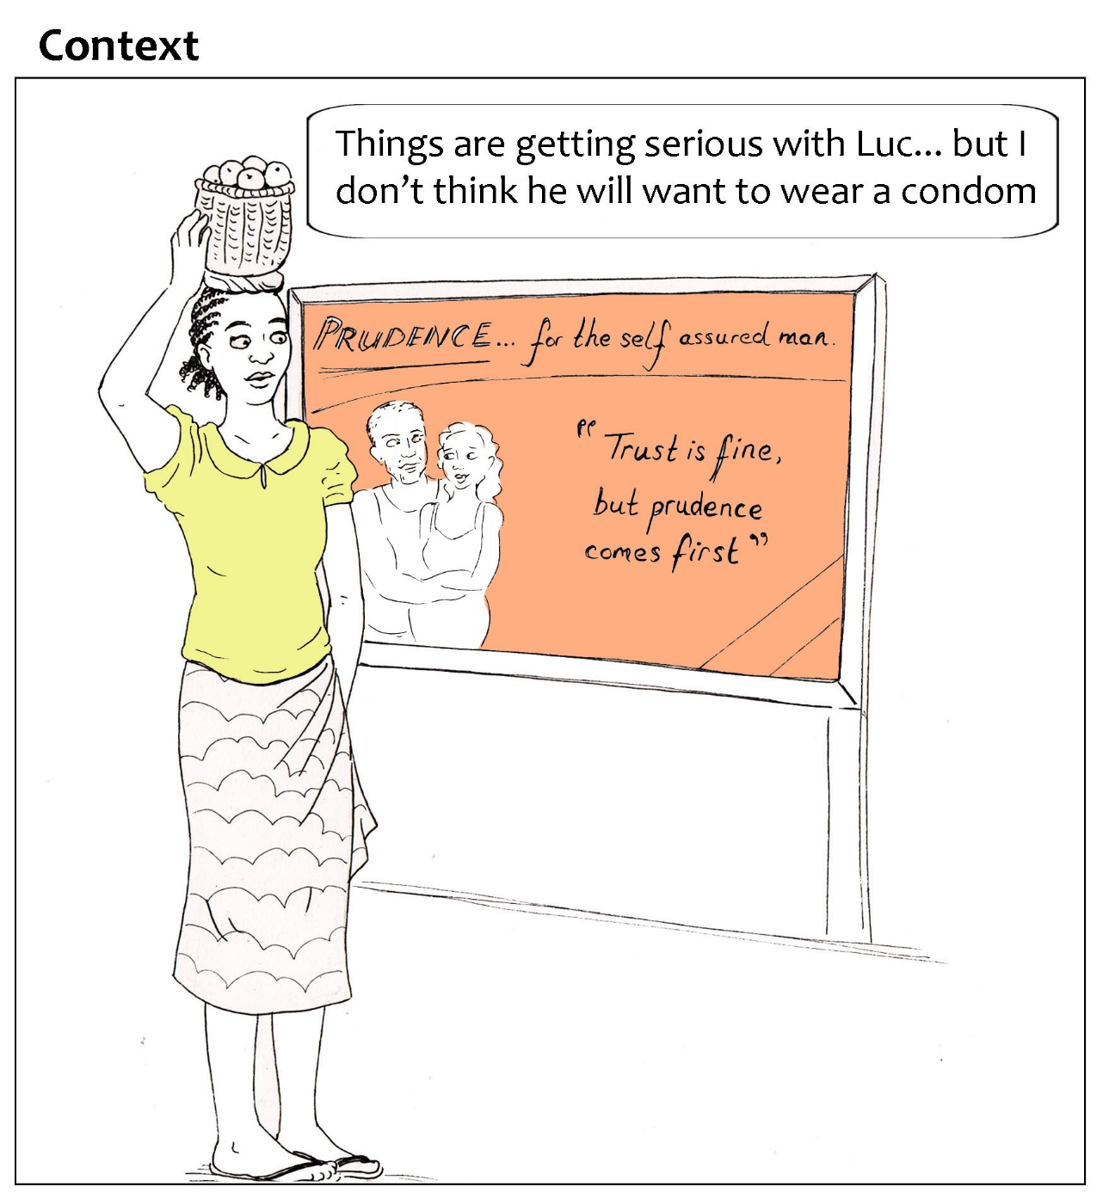
Trust in sexual health decision-making
Scenario 3: Interpretation as imagined futures
Illustrations by Rachel Ayrton & Jo Le Prevost
Notes:
The third scenario explores sexual decision-making in a context of high HIV prevalence, and was inspired by a sexual health campaign undertaken in Kinshassa, Democratic Republic of Congo, in the 1980s to promote condom use – the brand name and tag-line in the billboard are original (Piot 2012).

Slide 20
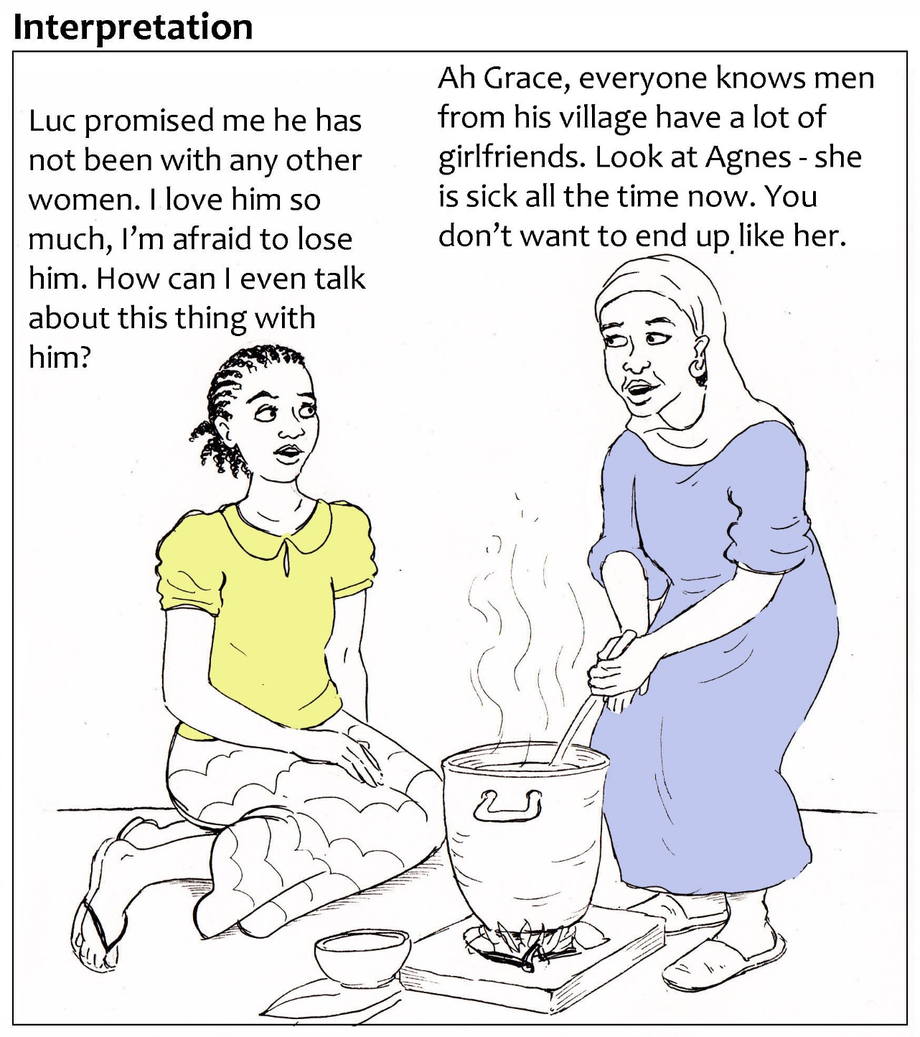
Scenario 3: Interpretation as imagined futures
Notes:
Unlike the previous scenarios, this one focuses on an intimate relationship. As Grace considers the possibility of sex with her partner Luc, she involves a trusted friend in her process of interpretation where her emotions are in tension with popular wisdom and the recent experience of a known third party.

Slide 21
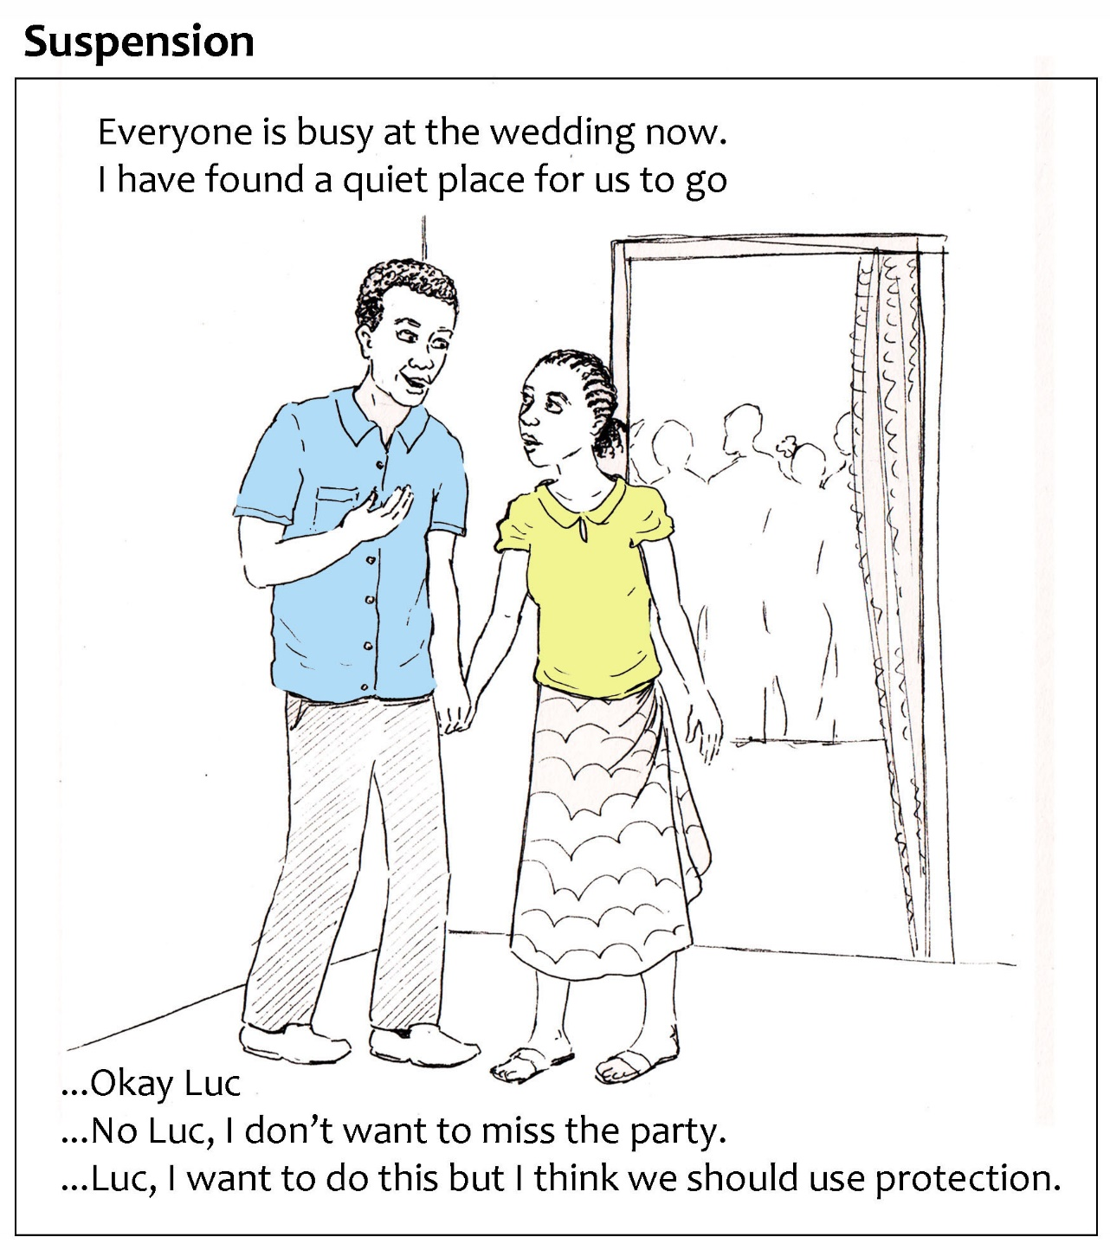
Scenario 3: Interpretation as imagined futures
…Okay Luc
Does this indicate trust? Or that she is undecided (agnostic) or distrusts Luc, but physical or emotional dimensions override; Or she lacks a language or is otherwise disempowered to engage in a discussion due to cultural taboos or agency of women in her society?
… No Luc, I don’t want to miss the party
Distrust? Or agnostic – still in interpretation so not ready to suspend? Or she really does want to stay at the party?!
… I want to do this but I think we should use protection
Distrust/agnostic – she doesn’t believe he is not at risk of infection? Or perhaps the greater perceived vulnerability is losing him, so this indicates trust: the leap of faith to raise her concerns and feelings?
Notes:
As the dilemma reached a moment of decision, I found myself wrestling with the conventions of the storyboarding task – that it must include the telling and resolution of a story. I initially assumed that trusting Luc would involve proceeding with sex without instigating a conversation around condom use; however, I realised that this was exactly the kind of external labelling of behaviour I was seeking to avoid. In fact, each of the three responses in the ‘suspension’ frame could have a variety of interpretations indicating trust, distrust, or agnosticism.
I became concerned about how contrived the story had the potential to be, and in particular the risk of stigmatising people in situations like thos of my characters through my representation of them.

Slide 22
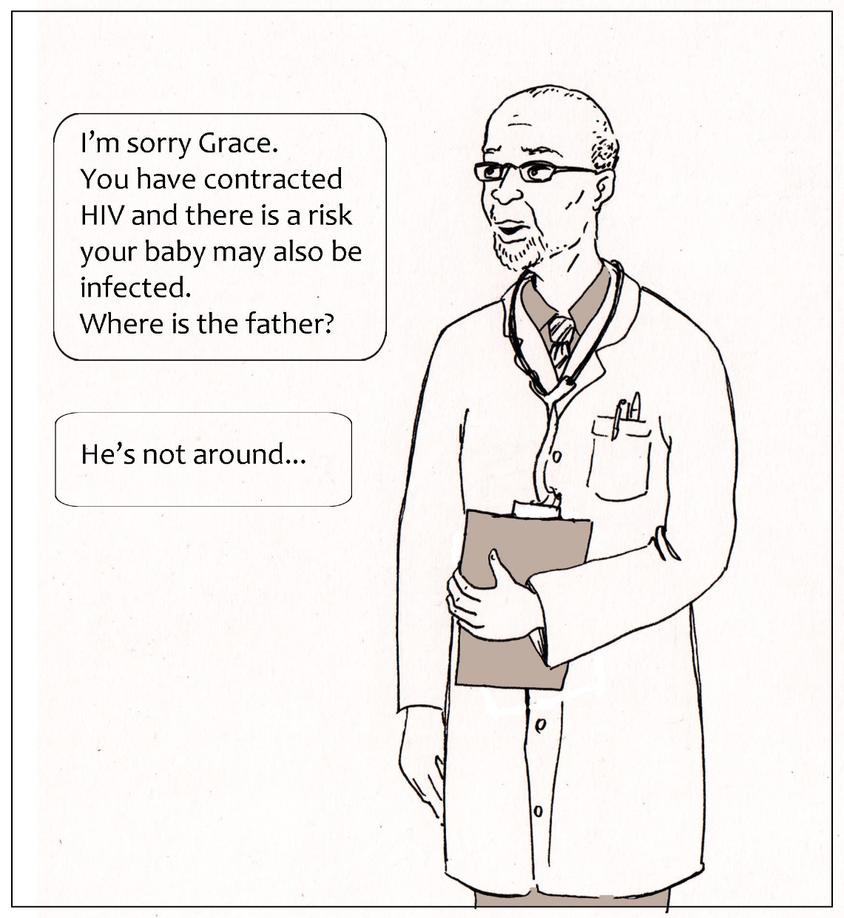
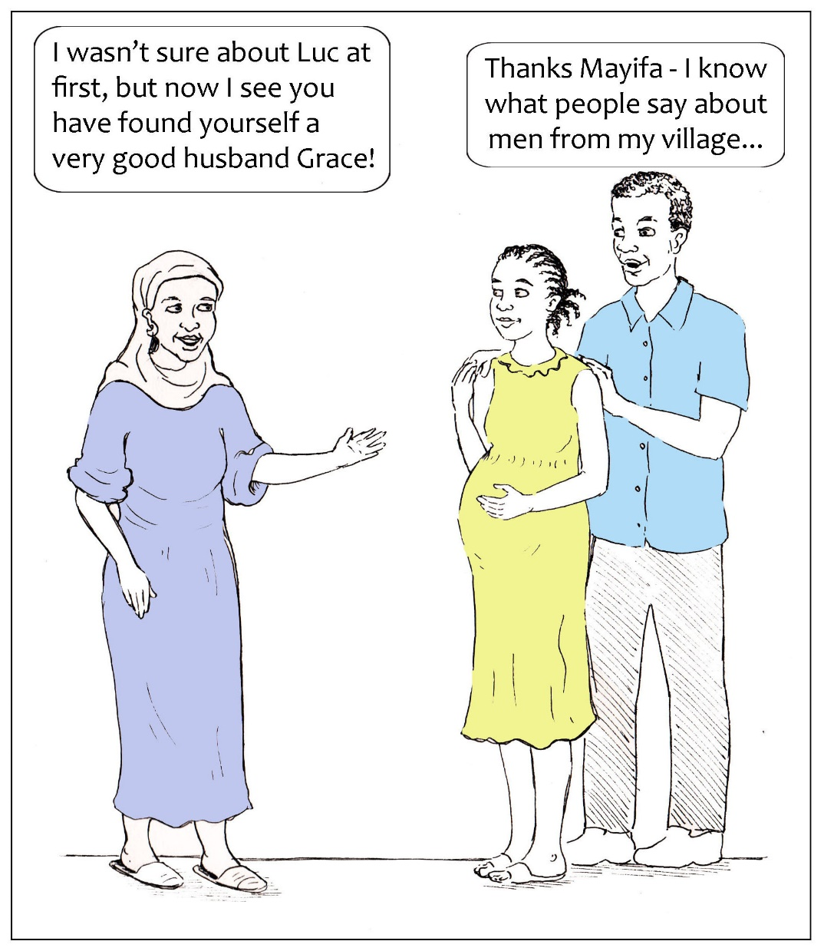
(Un)Favourable Expectation … or imagined futures?
Scenario 3: Interpretation as imagined futures
Notes:
Instead of reaching a resolution, I decided to open up a range of favourable (or unfavourable) expectations that Grace might arrive at when she makes her leap of faith. The breaking of artistic forms enabled progress (McNiff 2011). I realised that it was likely Grace would have contemplated these possible futures as part of the process of interpretation. This underlines the interconnections between stages in the trust process and reaffirms that this process is a conceptual construction, a tool for thinking that can be powerful analytically without these stages being neatly distinguishable in empirical reality.

Slide 23
(Un)Favourable Expectation … or imagined futures?
Scenario 3: Interpretation as imagined futures
Immediate response/ outcome
Luc dumps Grace
Decision is postponed
Sex without protection
Sex with protection
Luc suggests they both get tested so they can be sure they are safe.
Medium term outcome
Grace is happy with another man.
Grace is single and Luc has spread vicious rumours about her
Grace and Luc are still together; both of them are HIV+ but they do not know.
Grace and Luc will soon be married. They used protection until they could be tested for HIV.
Long term outcome
No one will marry Grace because she is HIV+ and has another man’s child.
Grace and Luc are married to different people. They are all now HIV+. None of them know this.
Notes:
In the context of the interpretive, in-depth qualitative methods that are suited to investigating a process approach to trust it would be easy to fall into asking questions that would implicitly illicit a rationalist response; however, based on the tentative reworking of ‘favourable expectations’ as one among possible ‘imagined future’, I might ask, “what did you imagine might happen depending on how you acted?”

Slide 24
Reflexivity and the author’s habitus
Bourdieu: the habitus sets the “social limits of [the researcher’s] act of objectification” (Bourdieu 2000 [1997]: 120)
Images/art as revealing of their producers and a source of self-knowledge (Piirto 2002; Cole and Knowles 2008; Weber 2008)
Scenario 2 – emotional and political involvement with subject matter shaping expectations
Scenario 3 – ‘hysteresis’ and the loss of confidence in interpretative knowledge (Bourdieu 1989; Bourdieu and Wacquant 1992)
Scenario 1 – the risks of insider assumptions
Notes:
Bourdieu suggests that in research, the range of what is knowable is constrained by the habitus: a structured system of dispositions formed through absorbing the history of the social field in general and the agent’s own particular trajectory within it – “embodied history, internalized as second nature and so forgotten as history” (Bourdieu 1990 [1980]: 56). The habitus sets the “social limits of [the researcher’s] act of objectification” unless those social limits are actively brought to light.
Proponents of arts-based methods have suggested that images or art are revealing of their producers as well as the subject matter, and confer self-knowledge. Therefore, the process of producing visualisations has the potential to enable the reflexive analysis of the researcher’s own social position, and therefore to open the possibility of transcending these limitations in the empirical stages of research that follow. This became evident in the reflective notes that I kept alongside the activity of storyboarding.
As I worked on scenario 2, I was conscious that I have close friends with experiences similar to those of Nathan, and a relative who is a Consultant Psychiatrisst. I initially considered this as basically informative, but as I took on the role of the author, able to tell the story of my choosing, I became emotionally exercised by Nathan’s situation, and tempted to use the storyboard as a platform to air political views. There are clues to this struggle in the storyboard – in particular, Nathan’s invisibility – he is spoke about ‘behind closed doors’ in the first and last frame, and his face is never shown.
In scenario 2 and to a greater extent scenario 3 I felt troubled by my ability to dictate the outcome of the central characters and, implicitly, people like them that I did not want to presume to speak for. I was aware that creating representations of characters was not a morally neutral act (Tufte 2006). The social and cultural difference between myself and Grace, in particular, made me cripplingly aware that I could know virtually noting about how she might manage her vulnerabilities. Bourdieu uses the term ‘hysteresis’ to describe the experience of one’s habitus being out of synch with the social world in which one finds oneself. As a result I lost confidence in my own “practical mastery” or “feel for the game” (Bourdieu 1989; Bourdieu and Wacquant 1992) and became sensitised to the distance between the social worlds of my characters and any in which I would have tacit knowledge of how to act.
It is obvious perhaps that I conceive of myself as an ‘outsider’ to the experiences explored in scenarios 2 and 3. However, this caused me to reflect critically on the ease with which I manipulated the characters in scenario 1. Since I implicitly considered myself an ‘insider’ in Julie’s social world, taking aspects of it for granted, there is a risk of being blinded to power relations and dismissing as ‘the way things are’ aspects that might be significant in research (Bourdieu and Wacquant 1992: 127).

Slide 25
Visual/multimodal methods: capabilities and mechanisms
Capabilities
Encourages continuous attention to the construction of the sociological object
Suggests new dimensions of phenomena to be explored empirically
Revealing of how habitus limits the scope of what is ‘thinkable’ and knowable’ and predisposes the researcher towards certain kinds of findings
Mechanisms
The creative process: opening up and narrowing possibilities
Particular qualities of the visual: setting, point of view, what is included/excluded from the frame, perspective, style, use/significance of colour
Deliberative time to enter a reflective mode of thinking
Disrupts power relations between researchers and participants/audiences implicit in the dividing line between methods that are appropriate to each
Notes:
To sum up then, I will reiterate the capabilities of visual and multi-modal methods that I have found to be valuable in the pre-empirical activities of conceptualisation and research design, and suggest some of the mechanisms that I believe are at play that makes the contribution of visual methods distinctive.
In terms of capabilities, the use of visual/multimodal methods by researchers enhances the rigor of their conceptual and research design work. It encourages continuous attention to the construction of the sociological object; it suggests new dimensions of phenomena to be explored empirically; and it is revealing of how the habitus limits the scope of what is ‘knowable’ and predisposes the researcher to certain kinds of findings.
What are the distinctive mechanisms of the visual/multimodal that procure these benefits, that distinguish these tools from conventional verbal argumentation? There are (at least) three mechanisms at play. The first concerns the creative process, which iteratively opens up and narrows possibilities. Working through a trust scenario, for example, involves imagining many possible responses of the protagonist to their dilemma; however, at some point I had to choose one response, and account for the repercussions of that choice in detail. Movement between the general and the specific is at the heart of learning and the structured use of a creative process harnesses these skills. Secondly, the particular qualities of the visual pose unique questions: in particular, around setting, point of view, what is included or excluded from the frame, perspective, style, or the use/significance of colour. These decisions bring to light different facets of the object of research. Finally, aside from the visual/multimodal product itself, the process of its production opens up deliberative time to enter into a reflective mode of thinking which is conducive to the generation of new insights.
Finally, and returning to my earlier assessment of inward-facing and outward-facing facets of the research process, the application of visual/multimodal methods by the researcher has political implications it disrupts the power relations between researchers and their participants/audiences that are implicit in the dividing lines between the methods that are appropriate to each.

Slide 26
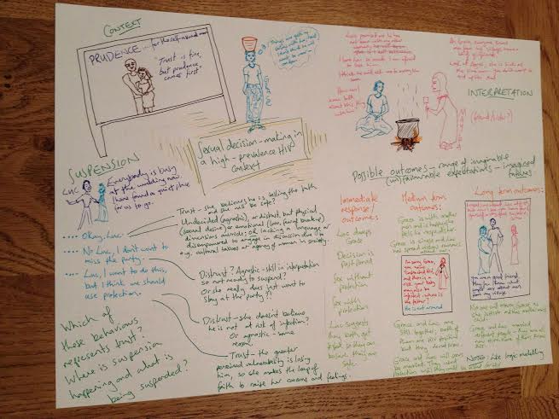
Thank you
@Rachel Ayrton
Rachel.Ayrton@soton.ac.uk

